Slide 1
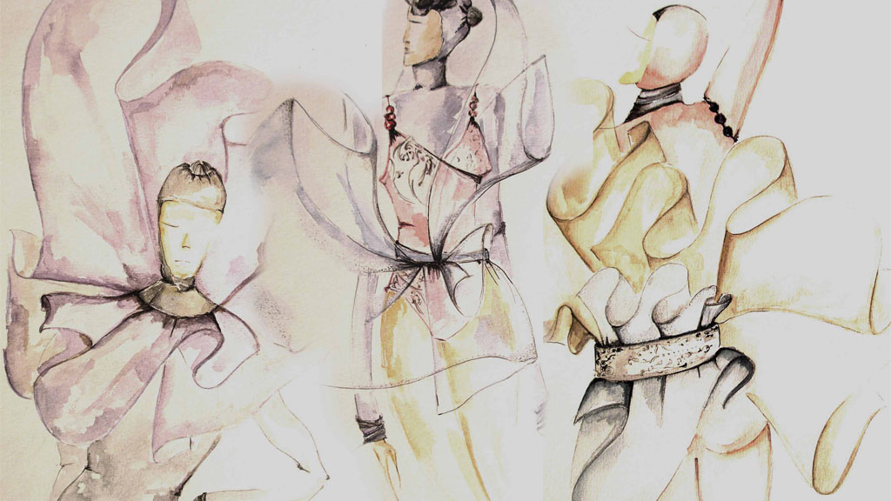
All Art is a gift of the Holy Spirit. When this light shines through the mind of a musician, it manifests itself in beautiful harmonies. Again, shining through the mind of a poet, it is seen in fine poetry and poetic prose. When the Light of the Sun of Truth inspires the mind of a painter, he produces marvellous pictures. These gifts are fulfilling their highest purpose, when showing forth the praise of God.
`Abdu'l-Baha

Slide 2
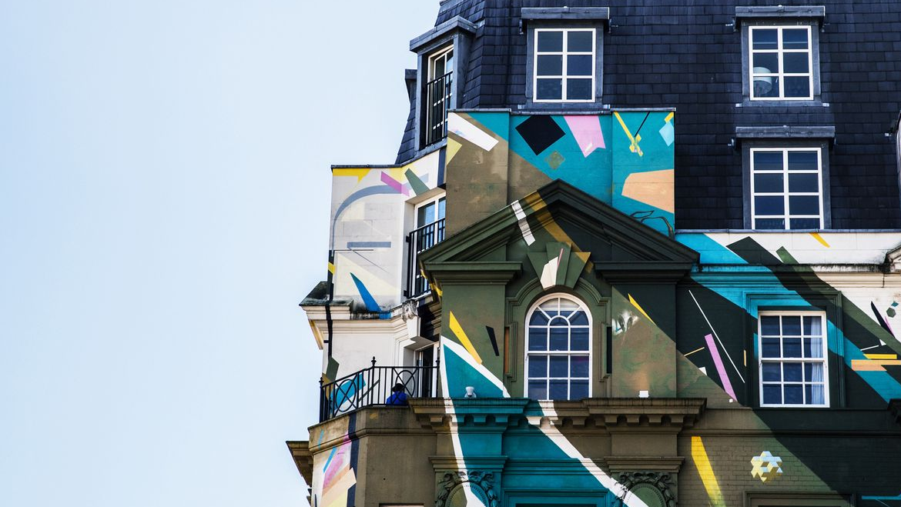
It is natural for the heart and spirit to take pleasure and enjoyment in all things that show forth symmetry, harmony, and perfection. For instance: a beautiful house, a well designed garden, a symmetrical line, a graceful motion, a well written book, pleasing garments — in fact, all things that have in themselves grace or beauty are pleasing to the heart and spirit.
`Abdu'l-Baha

Slide 3
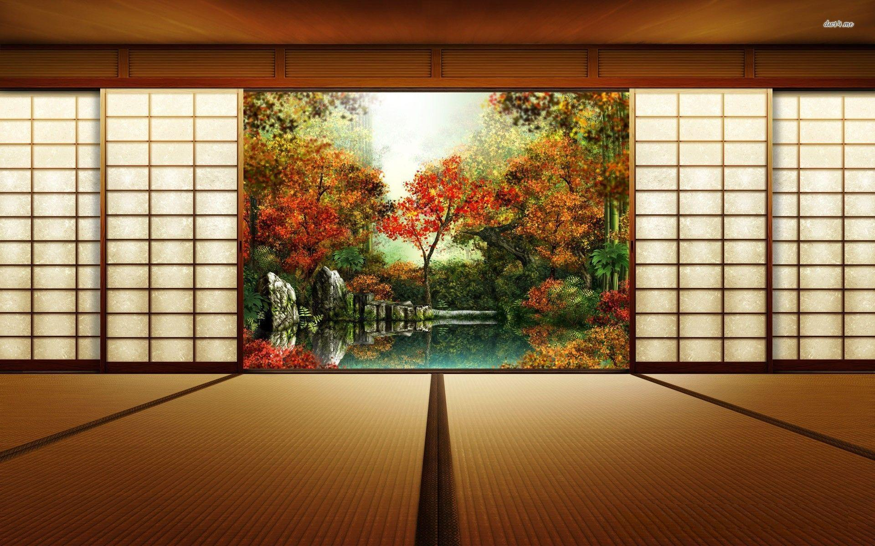
There is no place for grief in a house which serves the Muse.
Sappho

Slide 4
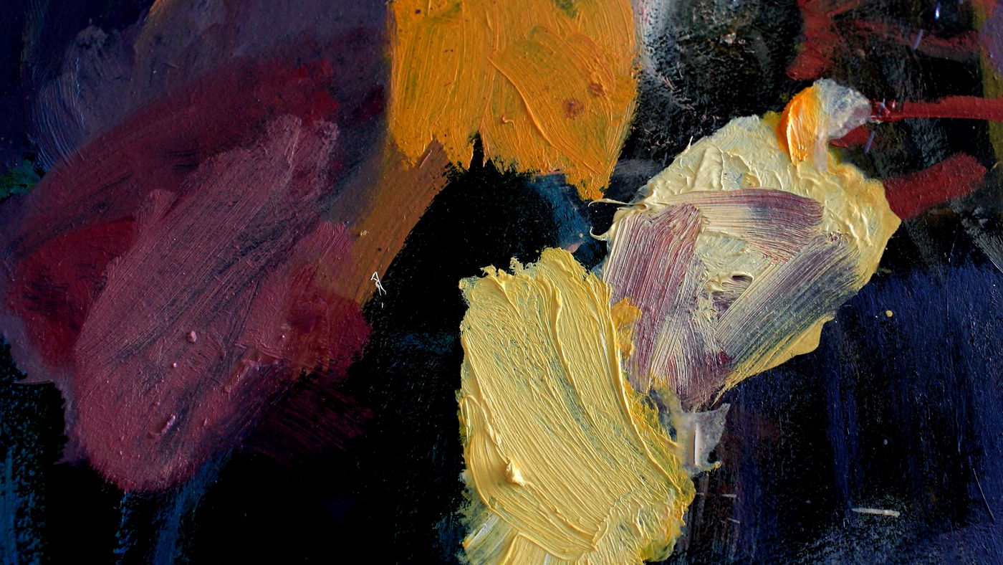
I rejoice to hear that thou takest pains with thine art, for in this wonderful new age, art is worship.
The more thou strivest to perfect it, the closer wilt thou come to God.
What bestowal could be greater than this, that one's art should be even as the act of worshipping the Lord? That is to say, when thy fingers grasp the paintbrush, it is as if thou wert at prayer in the Temple.
`Abdu'l-Baha

Slide 5
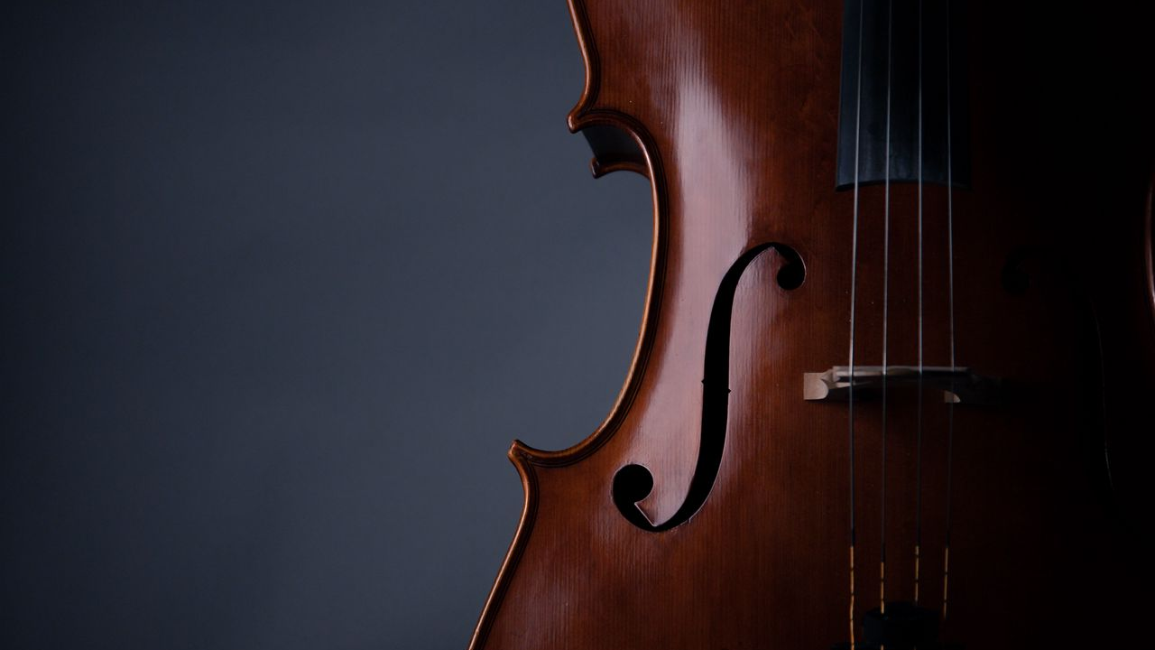
O musician of God!... The songsters of fellowship that abide in the gardens of holiness must pour forth such a triumphant burst of songs in this age that the birds in the fields may wing their flight in a transport of delight; and in this divine festival, this heavenly banquet, they should play the lute and the harp, and the viol and the lyre in such wise that the people of east and west may be filled with exceeding joy and gladness, and be carried away with exultation
and happiness.
`Abdu'l-Bahá

Slide 6
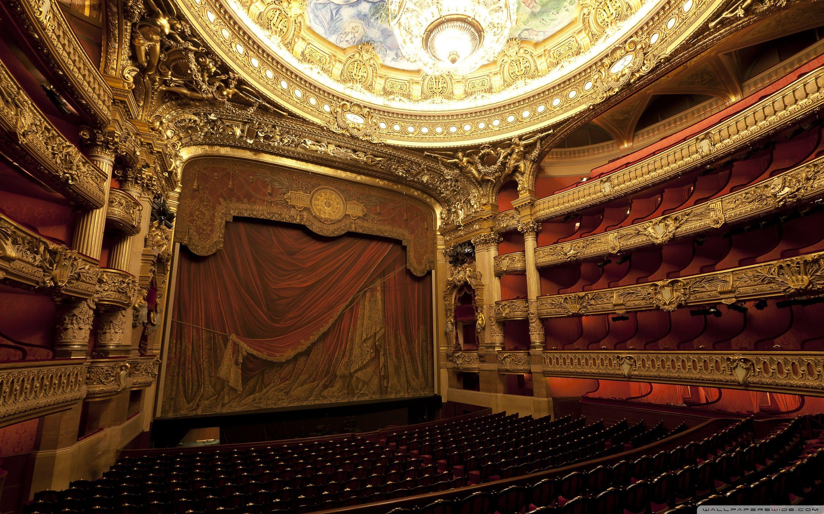
Drama is of the utmost importance. It has been a great educational power in the past; it will be so again…
The stage will be the pulpit of the future.
‘Abdu’l-Bahá

Slide 7

Every child is an artist. The problem is how to remain an artist once he grows up.
Pablo Picasso

Slide 8

The true worth of artists and craftsmen should be appreciated, for they advance the affairs of mankind. Bahá’u’lláh

Slide 9
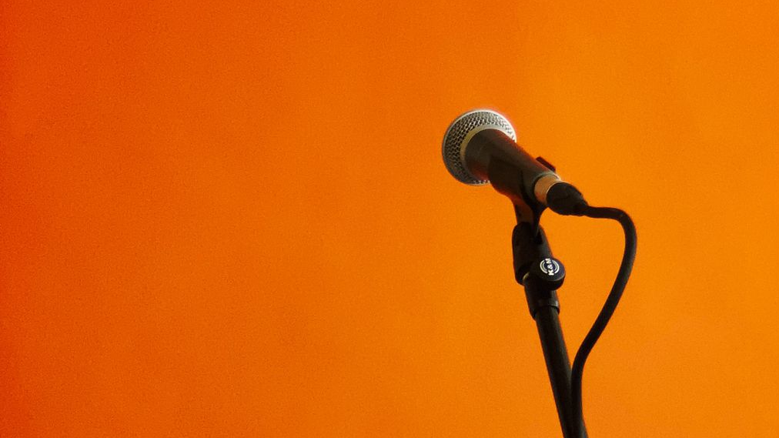
A fine voice when joined to beautiful music causes a great effect, for both are desirable and pleasing. All these have in themselves an organization, and are constructed on natural law.
Therefore they correspond to the order of existence like something which would fit into a mold. A true voice fits into the mold of nature. When it is so this affects the nerves, and they affect the heart and spirit. In the world of existence physical things have a connection with spiritual realities.
One of these things is the voice, which connects itself with the spirit; and the spirit can be uplifted by this means.
‘Abdu’l-Bahá

Slide 10
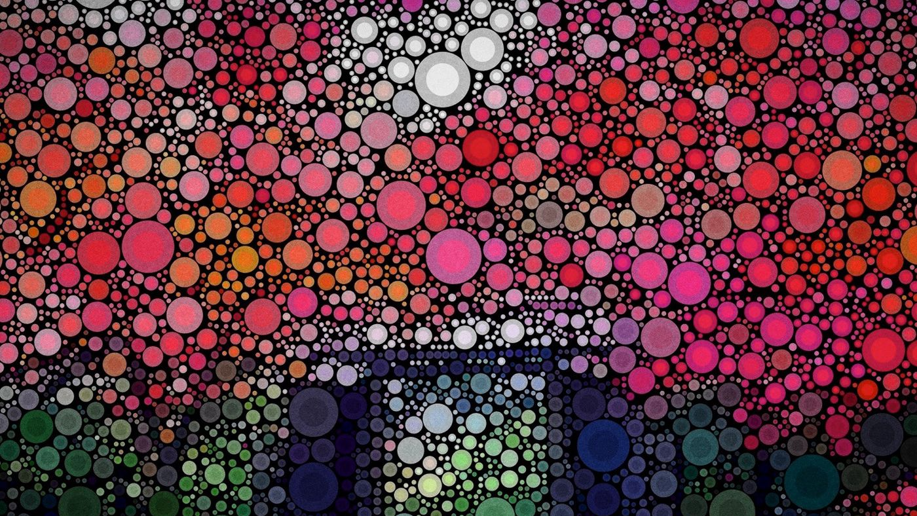
Every word of thy poetry is indeed like unto a mirror in which the evidences of the devotion and love thou cherishest for God and His chosen ones are reflected. Well is it with thee who hast quaffed the choice wine of utterance and partaken of the soft flowing stream of true knowledge.
Bahá’u’lláh

Slide 11
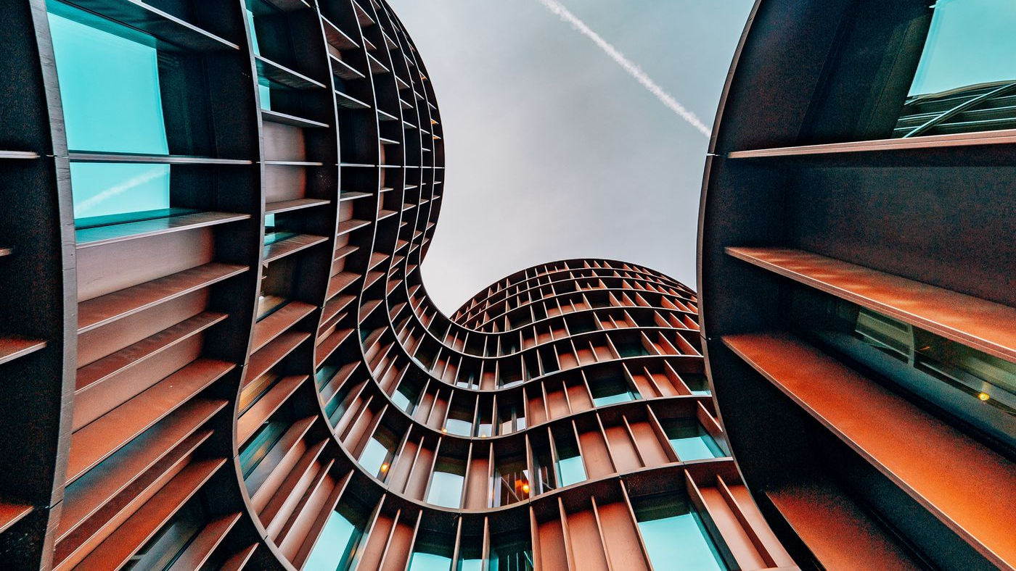
Creativity takes courage.
Henri Matisse

Slide 12
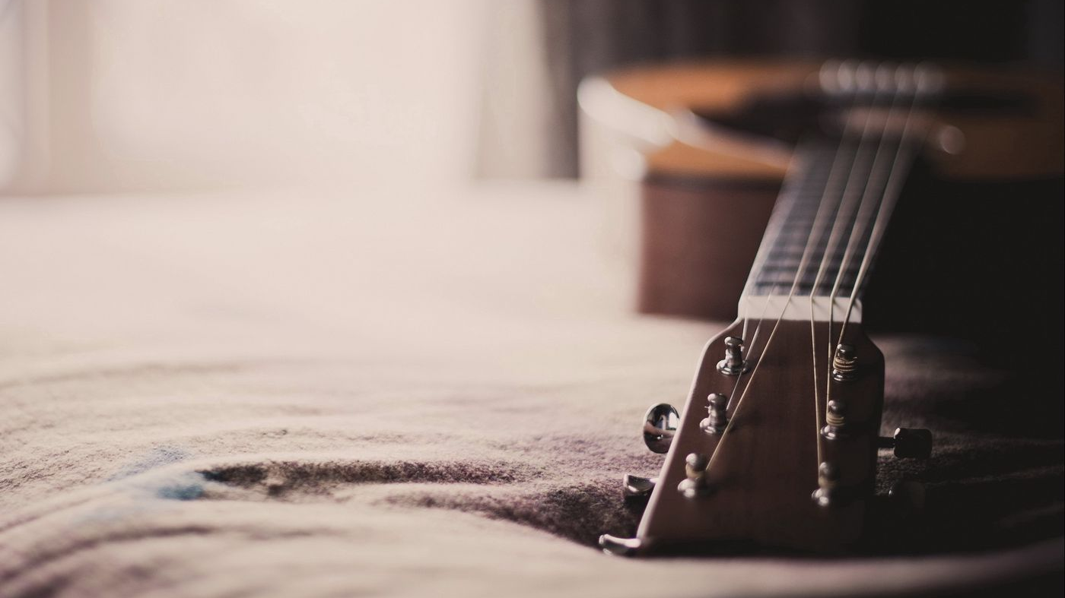
We, verily, have made music as a ladder for your souls, a means whereby they may he lifted up unto the realm on high.
Bahá’u’lláh

