Slide 1
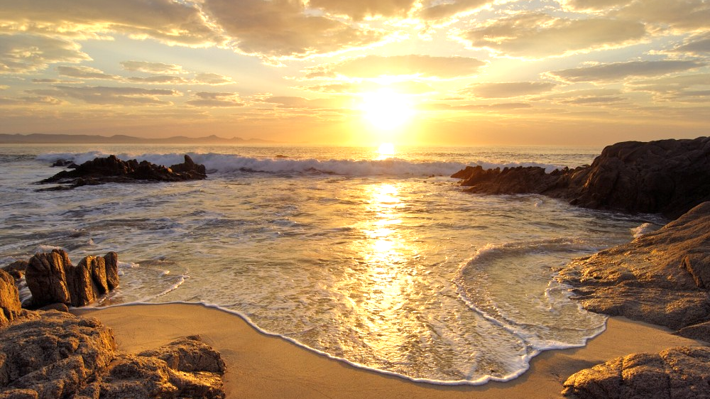
We would like to acknowledge the Custodians of the lands and waters where we meet tonight, and thank them for their eternal protection, love, and care of the space upon which we live.
We pay our respects to Elders past and present, and extend our respects to all Aboriginal and Torres Strait Islander First Nations Peoples.

Slide 2

[The true seeker] should be content with little, and be freed from all inordinate desire....
He should succour the dispossessed, and never withhold his favour from the destitute.
Baha’u’llah

Slide 3
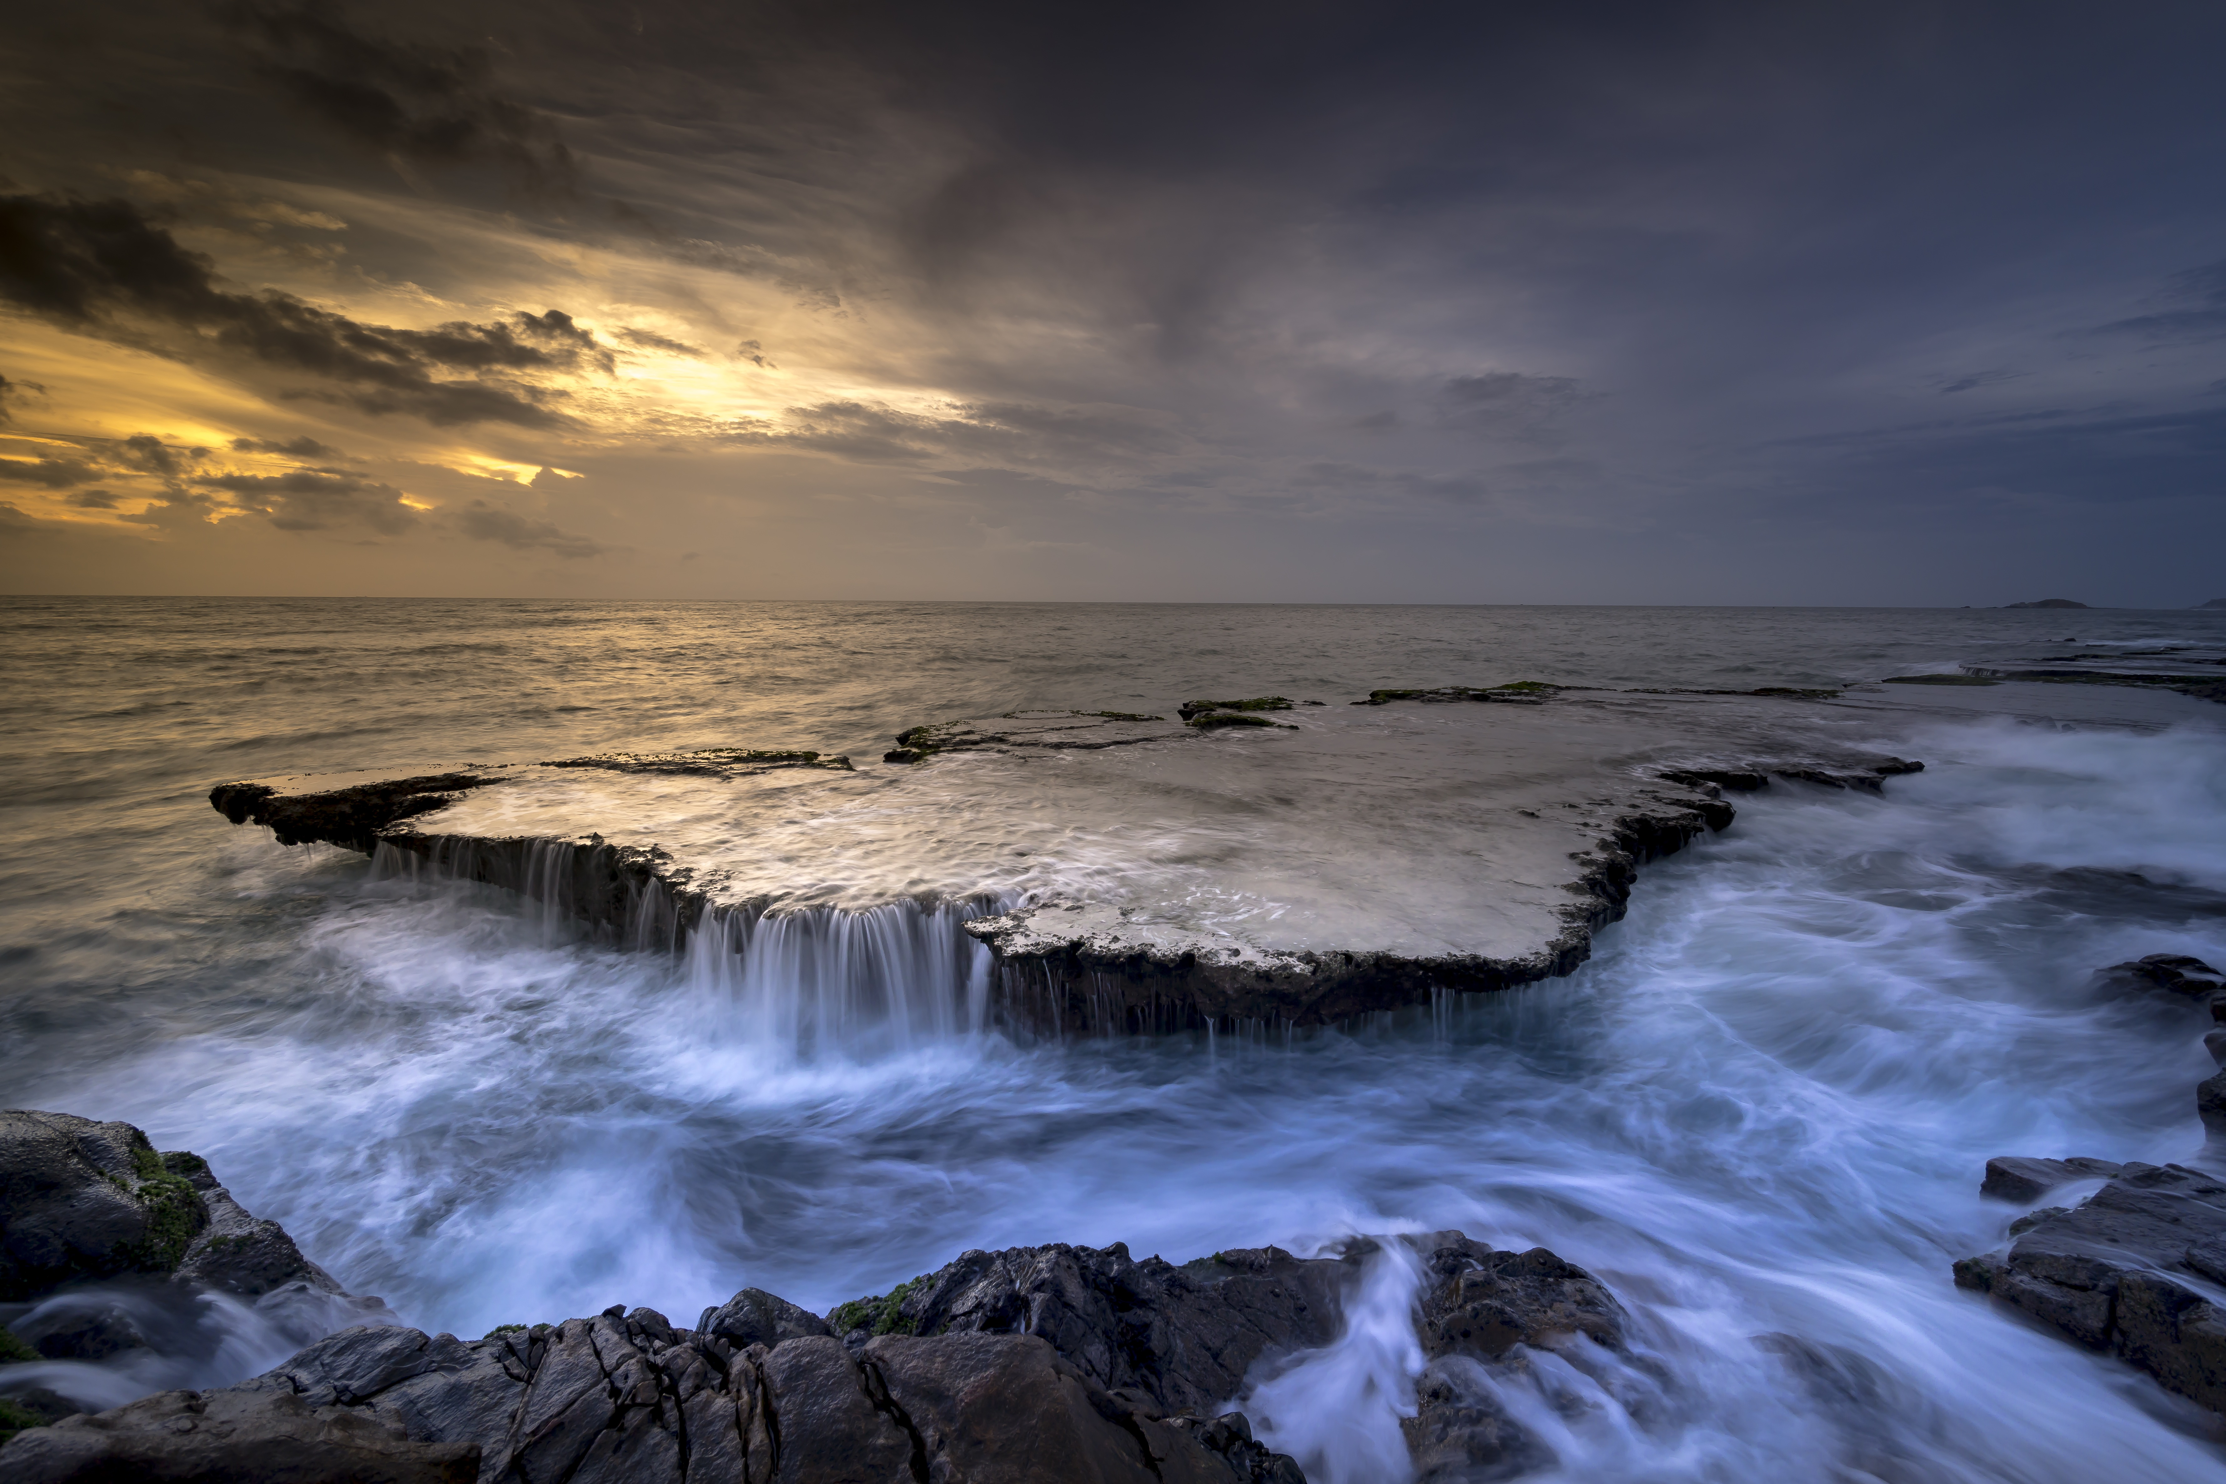
How complex is the life of the present age and how much more complex we are making it daily!
The needs of humanity seem never to come to an end. The more men accumulate the more they want. There is only one way of freedom and that is by shutting one's eyes and heart to all these things which distract the mind.
Abdu’l-Baha

Slide 4

Contentment makes poor men rich, discontent makes rich men poor.
Benjamin Franklin

Slide 5

And the wayfarer, after traversing the high planes of this supernal journey,
entereth The Valley of Contentment.
In this Valley he feeleth the winds of divine contentment blowing from the plane of the spirit.
He burneth away the veils of want, and with inward and outward eye, perceiveth within and without all things the day of: "God will compensate each one out of His abundance.”
From sorrow he turneth to bliss, from anguish to joy.
His grief and mourning yield to delight and rapture.
Although to outward view, the wayfarers in this Valley may dwell upon the dust, yet inwardly they are throned in the heights of mystic meaning; they eat of the endless bounties of inner significances, and drink of the delicate wines of the spirit…
For on this plane the traveler witnesseth the beauty of the Friend in everything. Even in fire, he seeth the face of the Beloved. He beholdeth in illusion the secret of reality, and readeth from the attributes the riddle of the Essence.
For he hath burnt away the veils with his sighing, and unwrapped the shroudings with a single glance; with piercing sight he gazeth on the new creation; with lucid heart he graspeth subtle verities. This is sufficiently attested by: "And we have made thy sight sharp in this day.”
Baha’u’llah

Slide 6
O SON OF MAN!
Be thou content with Me and seek no other helper.
For none but Me can ever suffice thee.
Baha’u’llah

Slide 7
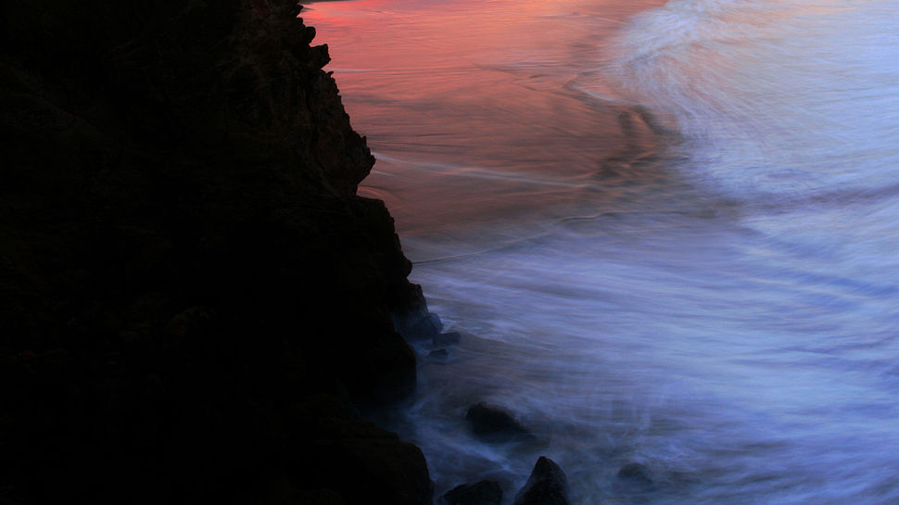
The more difficulties one sees in the world the more perfect one becomes.
The more you plough and dig the ground the more fertile it becomes.
The more you cut the branches of a tree the higher and stronger it grows.
The more you put the gold in the fire the purer it becomes....
That is why, in all times, the Prophets of God have had tribulations and difficulties to withstand.
The more often the captain of a ship is in the tempest and difficult sailing the greater his knowledge becomes.
Therefore I am happy that you have had great tribulations and difficulties....
Strange it is that I love you and still I am happy that you have sorrows.
Abdu’l-Baha

Slide 8
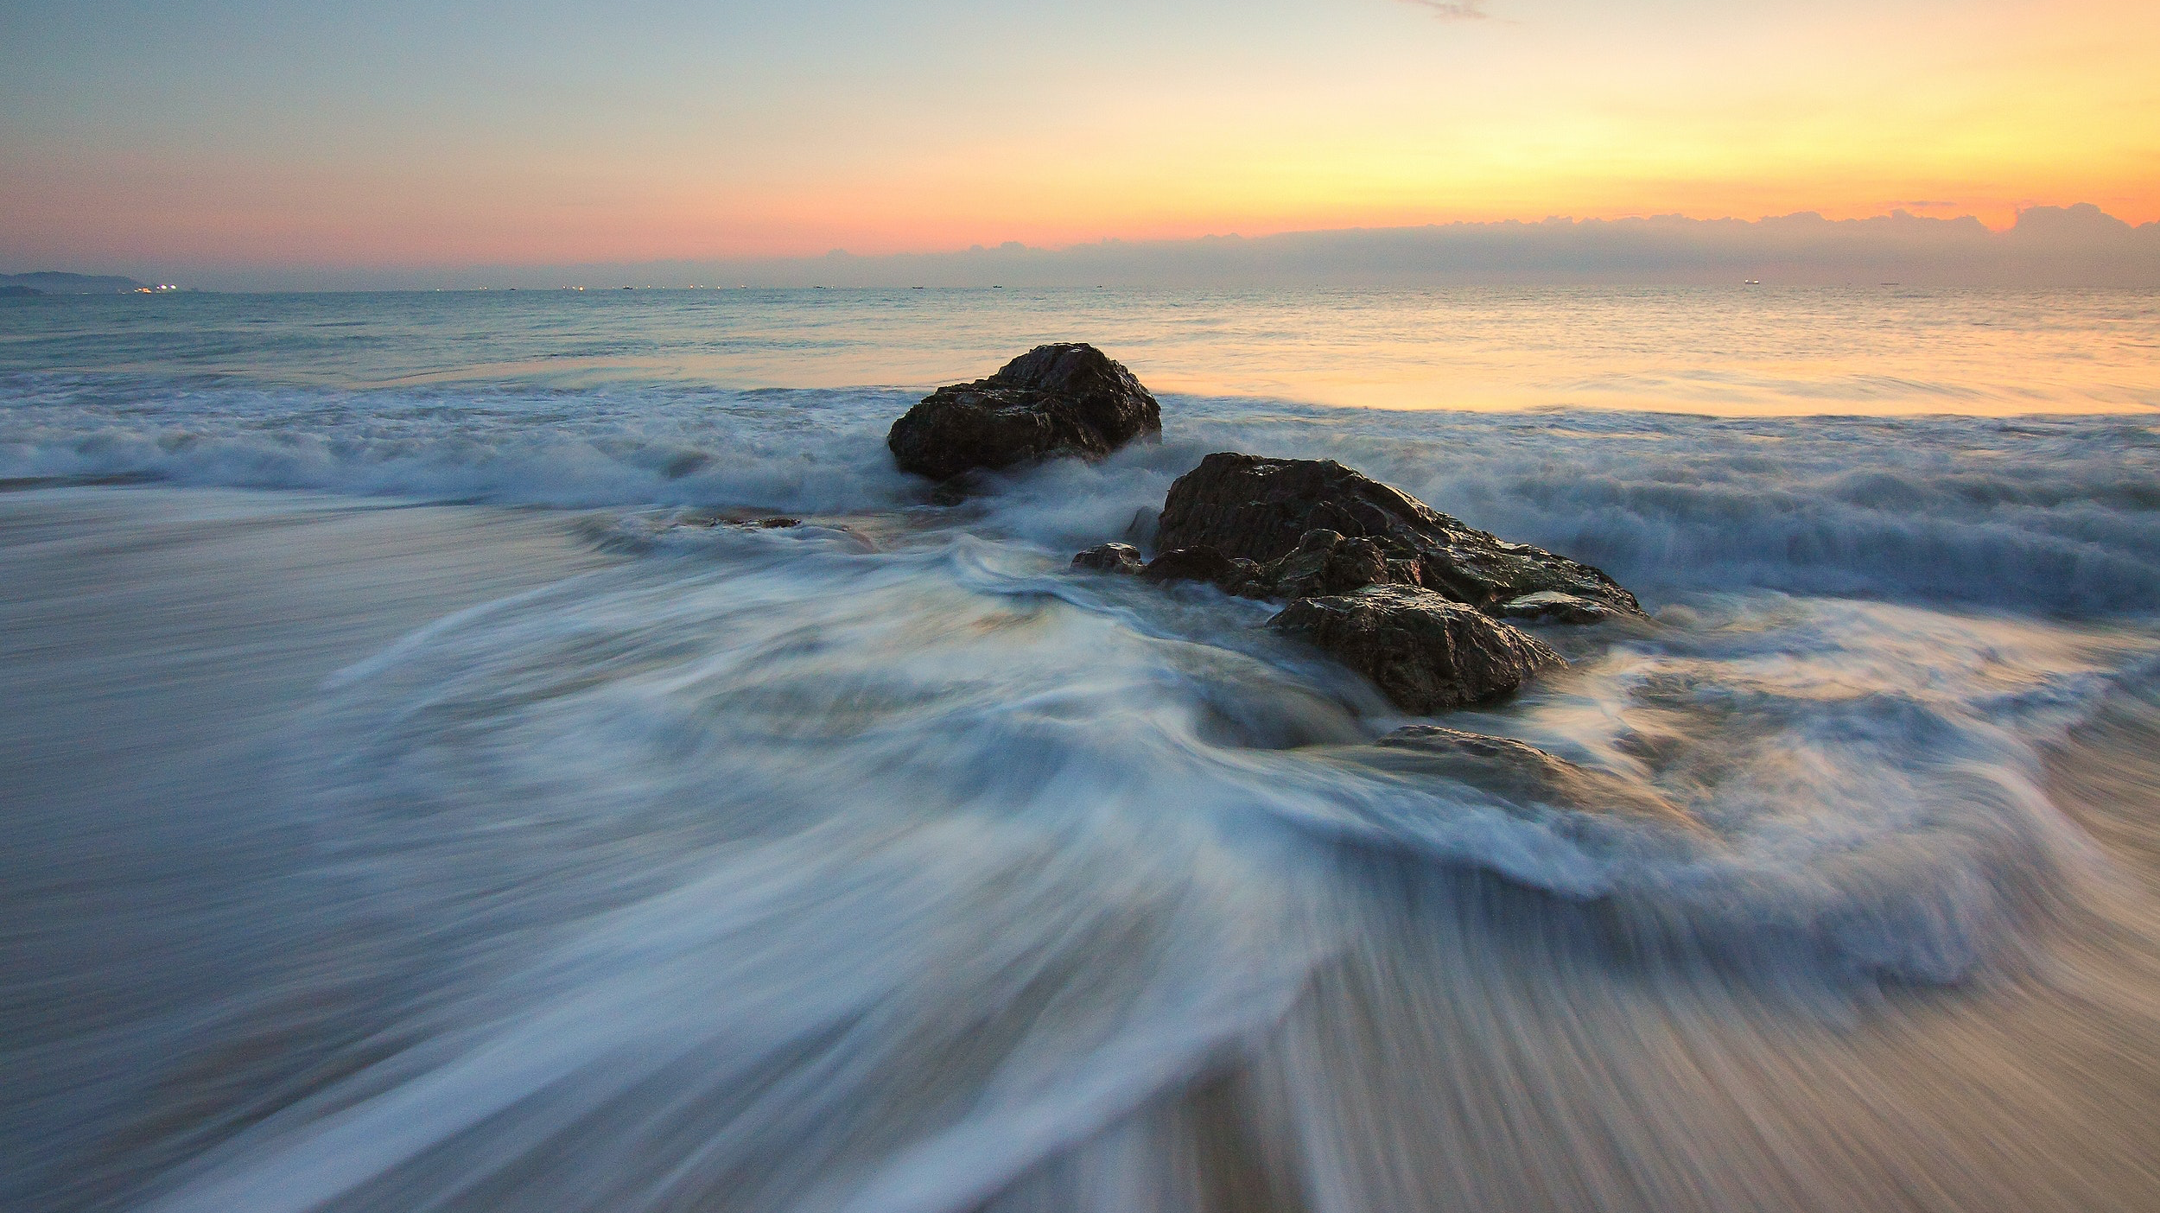
Where may I find contentment -
High on the mountain's crest?
Or there beside the sky-blue lake
that nestles on its breast?
Or in a quiet, elfin glen,
beside the rippling rills,
contemplating giant trees
and God's eternal hills?
It is not there beside the lake,
nor on the mountain peak,
nor in the valley far below,
the consolation that I seek.
But when the search has ended,
I'm sure that I will find
contentment in reality,
is just your state of mind.
Radhiya Fanham

Slide 9
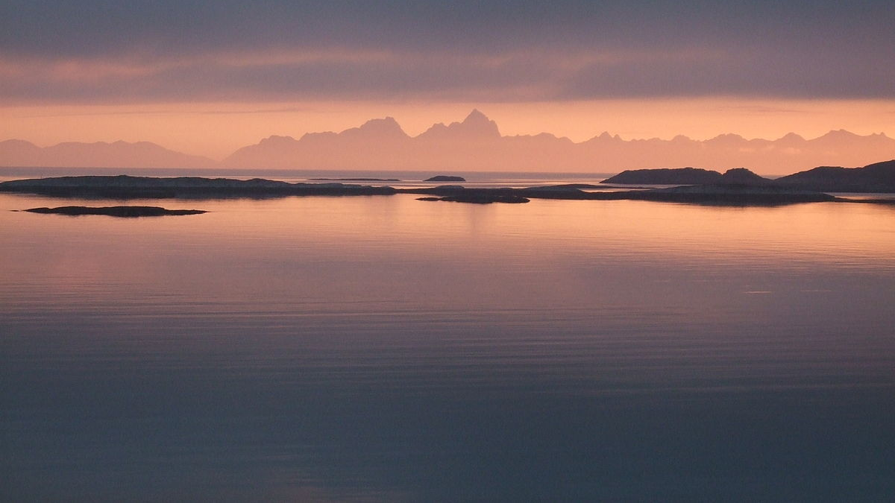
The virtues and attributes pertaining unto God are all evident and manifest, and have been mentioned and described in all the heavenly Books. Among them are trustworthiness, truthfulness, purity of heart while communing with God, forbearance, resignation to whatever the Almighty hath decreed, contentment with the things His Will hath provided, patience, nay, thankfulness in the midst of tribulation, and complete reliance, in all circumstances, upon Him. These rank, according to the estimate of God, among the highest and most laudable of all acts. All other acts are, and will ever remain, secondary and subordinate unto them.
Baha’u’llah

Slide 10

O QUINTESSENCE OF PASSION!
Put away all covetousness and seek contentment; for the covetous hath ever been deprived, and the contented hath ever been loved and praised.
Baha’u’llah

Slide 11

Sorrow prepares you for joy. It violently sweeps everything out of your house, so that new joy can find space to enter. It shakes the yellow leaves from the bough of your heart, so that fresh, green leaves can grow in their place. It pulls up the rotten roots, so that new roots hidden beneath have room to grow. Whatever sorrow shakes from your heart, far better things will take their place.
Rumi

Slide 12

A thankful person is thankful under all circumstances.
A complaining soul complains even if he lives in paradise.
Abdu’l-Baha

Slide 13

Anybody can be happy in the state of comfort, ease, health, success, pleasure and joy; but if one will be happy and contented in the time of trouble, hardship and prevailing disease, it is the proof of nobility.
Abdu’l-Baha

