Slide 1
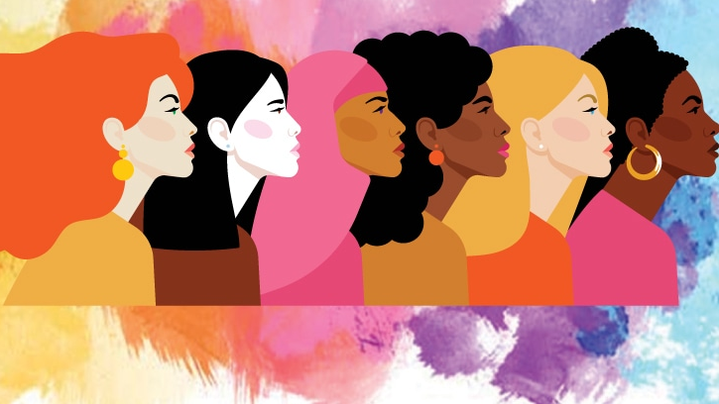
Until the reality of equality between man and woman is fully established and attained, the highest social development of mankind is not possible. …
The only remedy is education, opportunity; for equality means equal qualification.
ʻAbdu'l-Bahá

Slide 2
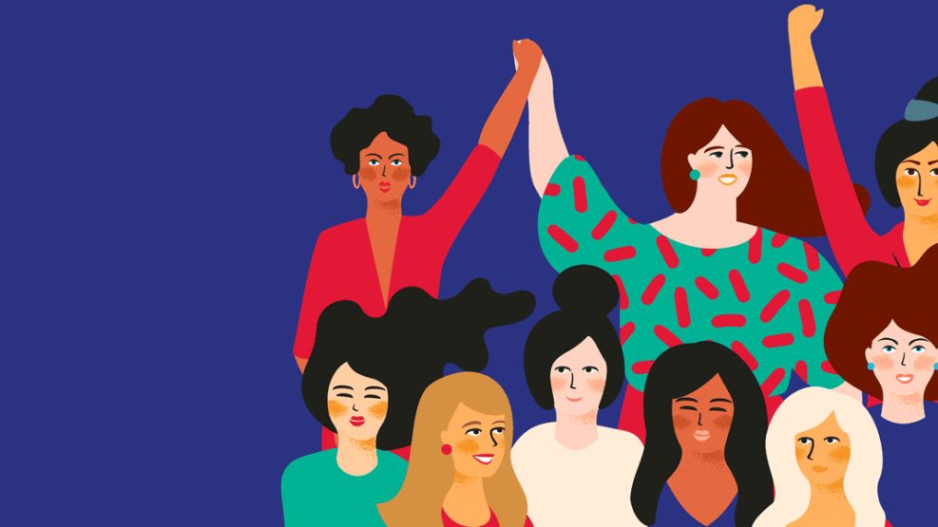
Women have equal rights with men upon earth; in religion and society they are a very important element.
As long as women are prevented from attaining their highest possibilities, so long will men be unable to achieve the greatness which might be theirs.
ʻAbdu'l-Bahá

Slide 3

I do not wish women to have power over men; but over themselves.
Mary Shelley

Slide 4
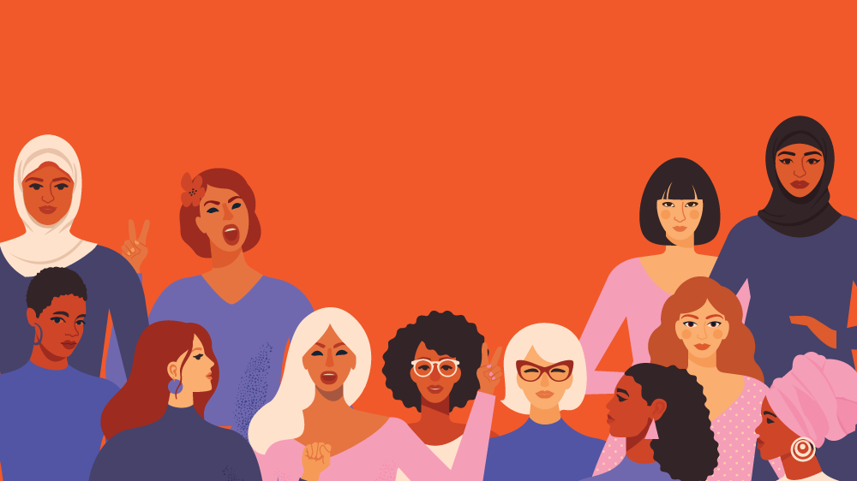
In this Revelation of Bahá’u’lláh, the women go neck and neck with the men. In no movement will they be left behind. Their rights with men are equal in degree. They will enter all the administrative branches of politics. They will attain in all such a degree as will be considered the very highest station of the world of humanity and will take
part in all affairs. Rest ye assured. Do ye not look upon the present
condition; in the not far distant future the
world of women will become all-refulgent
and all-glorious. For His Holiness
Baha’u’llah Hath Willed It so!
ʻAbdu'l-Bahá

Slide 5
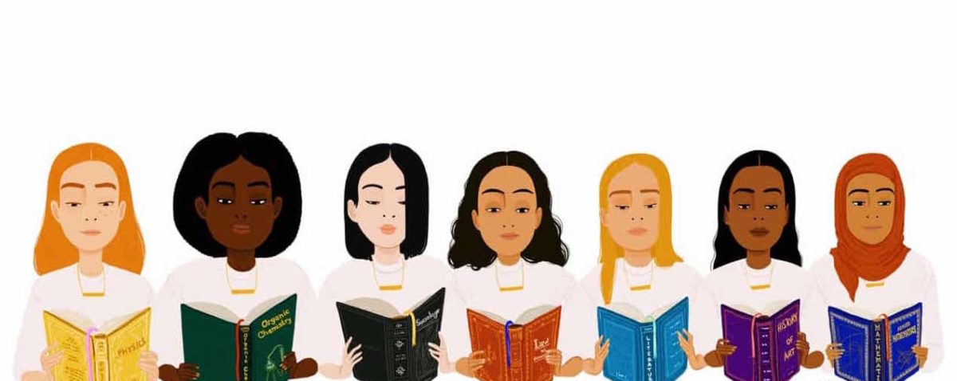
Over a century ago, and for the first time in the history of revealed religion, Bahá’u’lláh, Prophet-Founder of the Baháʼí Faith, proclaimed the equality of man and woman. He did not leave this pronouncement as an ideal or pious hope but wove it, as a basic factor, into the fabric of His social order. He supported it by laws requiring the same standard of education for women as for men, and equality of rights in society.
Equality of the sexes is, for Baháʼís, a spiritual and moral standard essential for the unification of the planet and the unfoldment of world order. Without the qualities, talents, and skills of both women and men, full economic and social development of the planet becomes impossible.
Baháʼí International Community

Slide 6
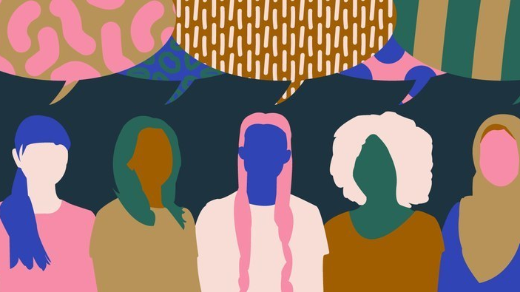
If there is not money enough in a family to educate both the girl and the boy the money must be dedicated to the girl’s education, for she is the potential mother.
ʻAbdu'l-Bahá

Slide 7

I raise up my voice—not so that I can shout, but so that those without a voice can be heard. … We cannot all succeed when half of us are held back.
Malala Yousafzai

Slide 8

[T]he principle of religion has been revealed by Bahá’u’lláh that woman must be given the privilege of equal education with man and full right to his prerogatives. That is to say, there must be no difference in the education of male and female in order that womankind may develop equal capacity and importance with man in the social and economic equation. Then the world will attain unity and harmony. In past ages humanity has been defective and inefficient because it has been incomplete. War and its ravages have blighted the world; the education of woman will be a mighty step toward its abolition and ending, for she will use her whole influence against war. Woman rears the child and educates the youth to maturity. She will refuse to give her sons for sacrifice upon the field of battle. In truth, she will be the greatest factor in establishing universal peace and international arbitration. Assuredly, woman will abolish warfare among mankind.
ʻAbdu'l-Bahá

Slide 9
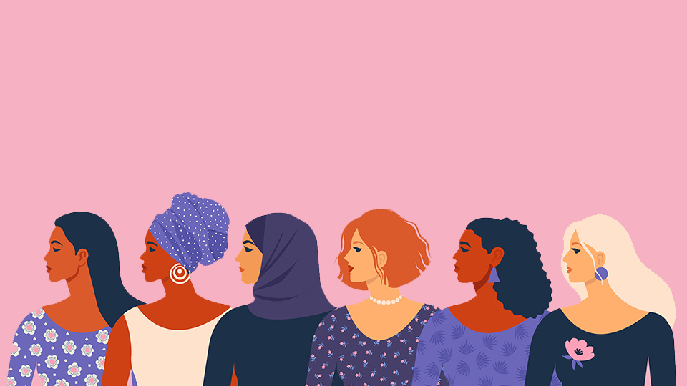
… let it be known once more that until woman and man recognize and realize equality, social and political progress here or anywhere will not be possible. For the world of humanity consists of two parts or members: one is woman; the other is man. Until these two members are equal in strength, the oneness of humanity cannot be established, and the happiness and felicity of mankind will not be a reality.
ʻAbdu'l-Bahá

Slide 10
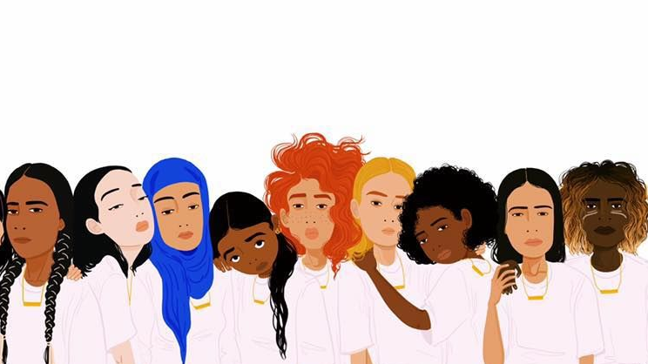
In the course of the current year which has been designated “International Women’s Year” as a world-wide activity of the United Nations, the Baháʼís… should initiate and implement programs which will stimulate and promote the full and equal participation of women in all aspects of Baháʼí community life, so that through their accomplishments the friends will demonstrate the distinction of the Cause of God in this field of human endeavour.
The Universal House of Justice

Slide 11
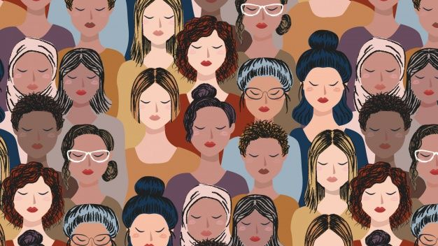
A feminist is anyone who recognizes the equality and full humanity of women and men.
Gloria Steinem

Slide 12

Exalted, immensely exalted is He Who hath removed differences and established harmony. Glorified, infinitely glorified is He Who hath caused discord to cease, and decreed solidarity and unity. Praised be God, the Pen of the Most High hath lifted distinctions from between His servants and handmaidens, and, through His consummate favours and all-encompassing mercy, hath conferred upon all a station and rank of the same plane. He hath broken the back of vain imaginings with the sword of utterance and hath obliterated the perils of idle fancies through the pervasive power of His might.
Bahá'u'lláh

