Slide 1

Nature is God's Will and is its expression in and through the contingent world.
Baháʼu'lláh

Slide 2
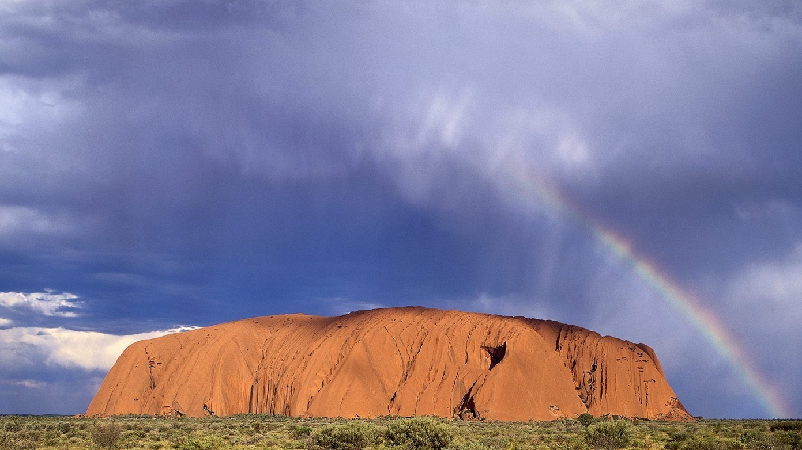
Were one to observe with an eye that discovereth the realities of all things, it would become clear that the greatest relationship that bindeth the world of being together lieth in the range of created things themselves, and that co-operation, mutual aid and reciprocity are essential characteristics in the unified body of the world of being, inasmuch as all created things are closely related together and each is influenced by the other or deriveth benefit therefrom, either directly or indirectly.
ʻAbdu'l-Bahá

Slide 3
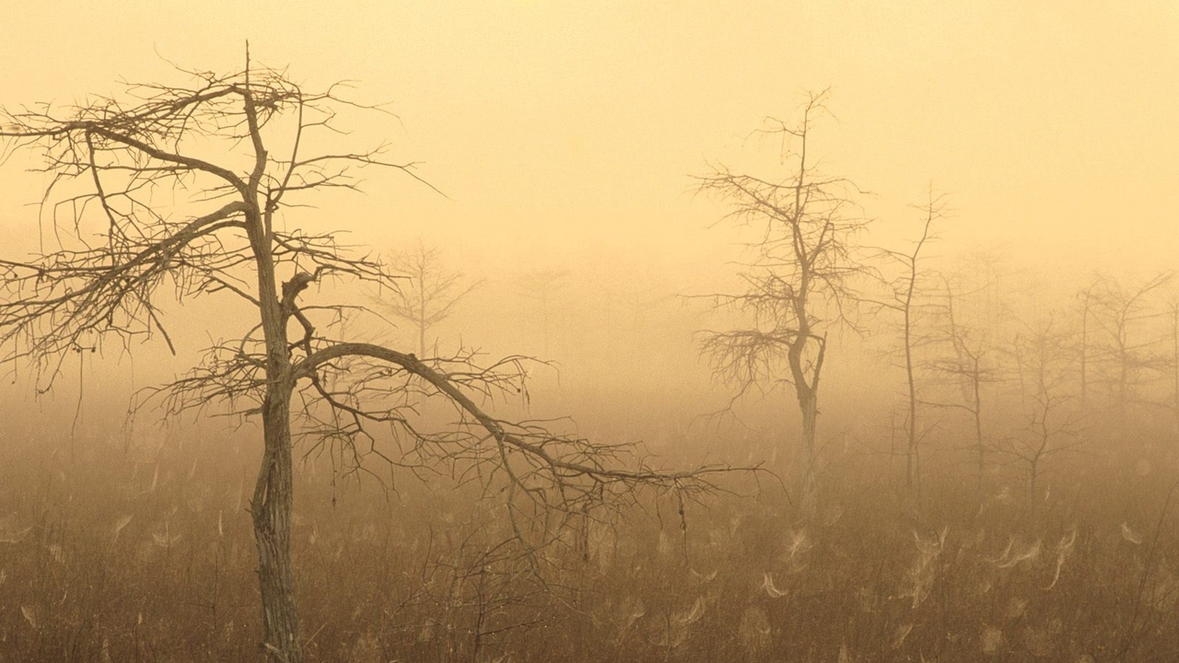
One of the first conditions of happiness is that the link between man and nature shall not be broken.
Leo Tolstoy

Slide 4

Briefly, it is not only their fellow human beings that the beloved of God must treat with mercy and compassion, rather must they show forth the utmost loving-kindness to every living creature.... The feelings are one and the same, whether ye inflict pain on man or on beast.
Train your children from their earliest days to be infinitely tender and loving to animals. If an animal be sick, let the children try to heal it, if it be hungry, let them feed it, if thirsty, let them quench its thirst, if weary, let them see that it rests.
ʻAbdu'l-Bahá

Slide 5
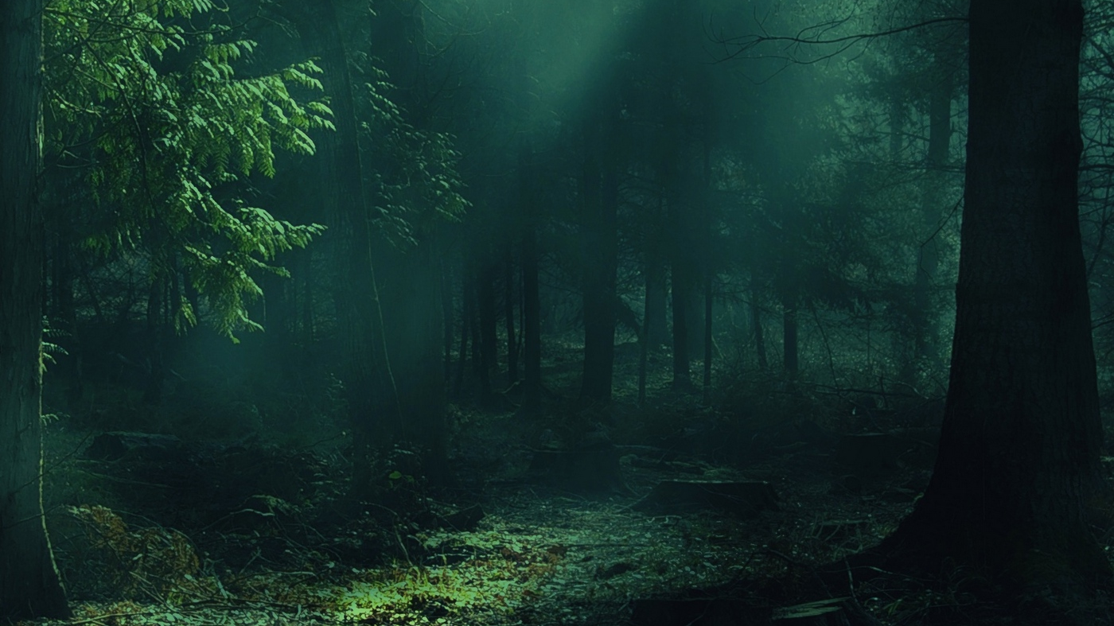
As trustees, or stewards, of the planet's vast resources and biological diversity, humanity must learn to make use of the earth's natural resources, both renewable and non-renewable, in a manner that ensures sustainability and equity into the distant reaches of time. This attitude of stewardship will require full consideration of the potential environmental consequences of all development activities. It will compel humanity to temper its actions with moderation and humility, realizing that the true value of nature cannot be expressed in economic terms. It will also require a deep understanding of the natural world and its role in humanity's collective development - both material and spiritual. Therefore, sustainable environmental management must come to be seen not as a discretionary commitment mankind can weigh against other competing interests, but rather as a fundamental responsibility that must be shouldered - a pre-requisite for spiritual development as well as the individual's physical survival.
Baháʼi International Community: Valuing Spirituality in Development Report

Slide 6

And whensoever thou dost gaze upon creation all entire, and dost observe the very atoms thereof, thou wilt note that the rays of the Sun of Truth are shed upon all things and shining within them, and telling of that Day-Star's splendours, Its mysteries, and the spreading of Its lights.
Look thou upon the trees, upon the blossoms and fruits, even upon the stones. Here too wilt thou behold the Sun's rays shed upon them, clearly visible within them, and manifested by them.
ʻAbdu'l-Bahá

Slide 7
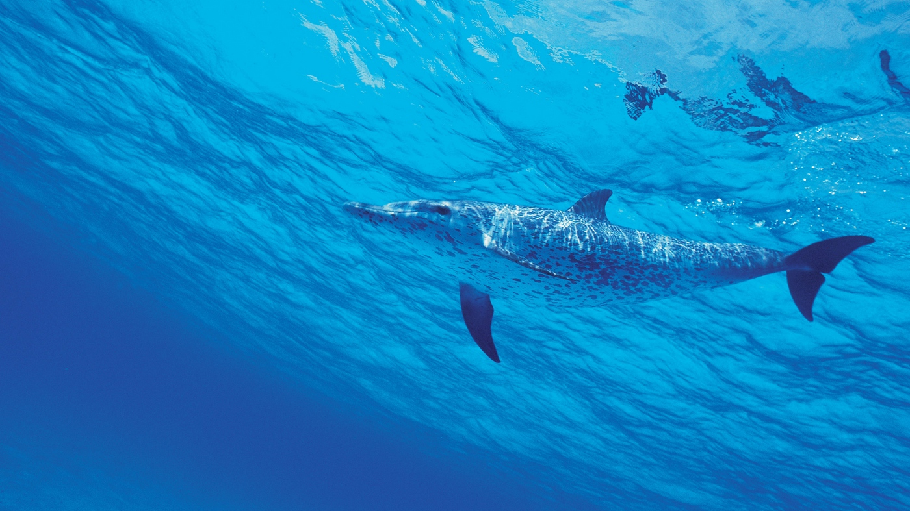
I only feel angry when I see waste. When I see people throwing away things we could use.
Mother Teresa

Slide 8
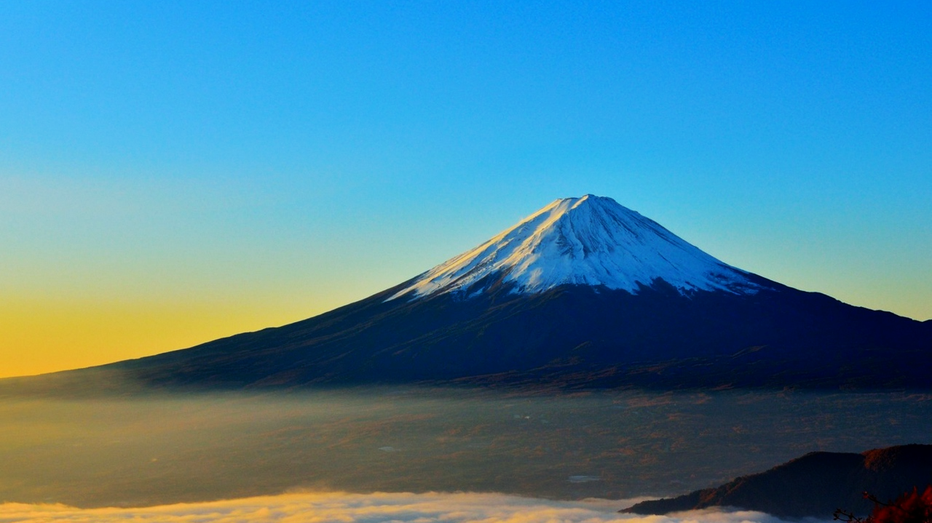
Every man of discernment, while walking upon the earth, feeleth indeed abashed, inasmuch as he is fully aware that the thing which is the source of his prosperity, his wealth, his might, his exaltation, his advancement and power is, as ordained by God, the very earth which is trodden beneath the feet of all men. There can be no doubt that
whoever is cognizant of this truth, is
cleansed and sanctified from all pride,
arrogance, and vainglory....
Baháʼu'lláh

Slide 9

It has been widely acknowledged that economic prosperity has come at a tremendous cost to our natural environment…
On an institutional level, a global entity with a strong scientific advisory capacity is needed to streamline reporting and decision-making processes, including the voices of non-state actors. It must coherently link environmental issues to social and economic priorities, for none of these can advance in isolation. At the educational level, curricula must seek to develop a sense of responsibility towards the natural environment as well as foster a spirit of inquiry and innovation so that the diversity of human experience can be brought to bear on the challenge of creating an environmentally sustainable development pathway.
Baháʼi International Community: Eradicating Poverty Report

Slide 10
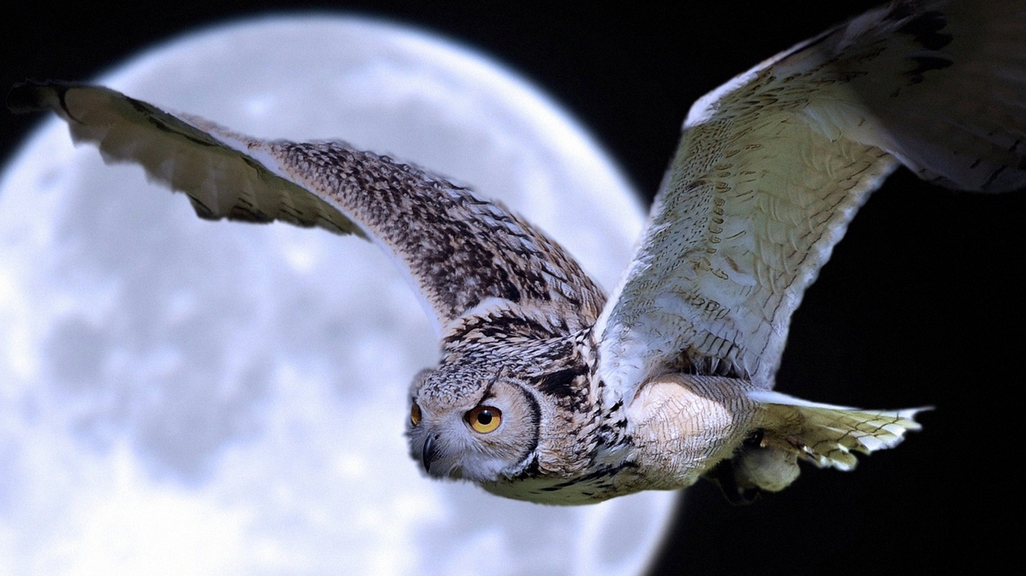
The elements and lower organisms are synchronized in the great plan of life.
Shall man, infinitely above them in degree, be antagonistic and a destroyer of that perfection?
ʻAbdu'l-Bahá

Slide 11

A nation that destroys its soils destroys itself. Forests are the lungs of our land, purifying the air and giving fresh strength to our people.
Franklin D. Roosevelt

Slide 12
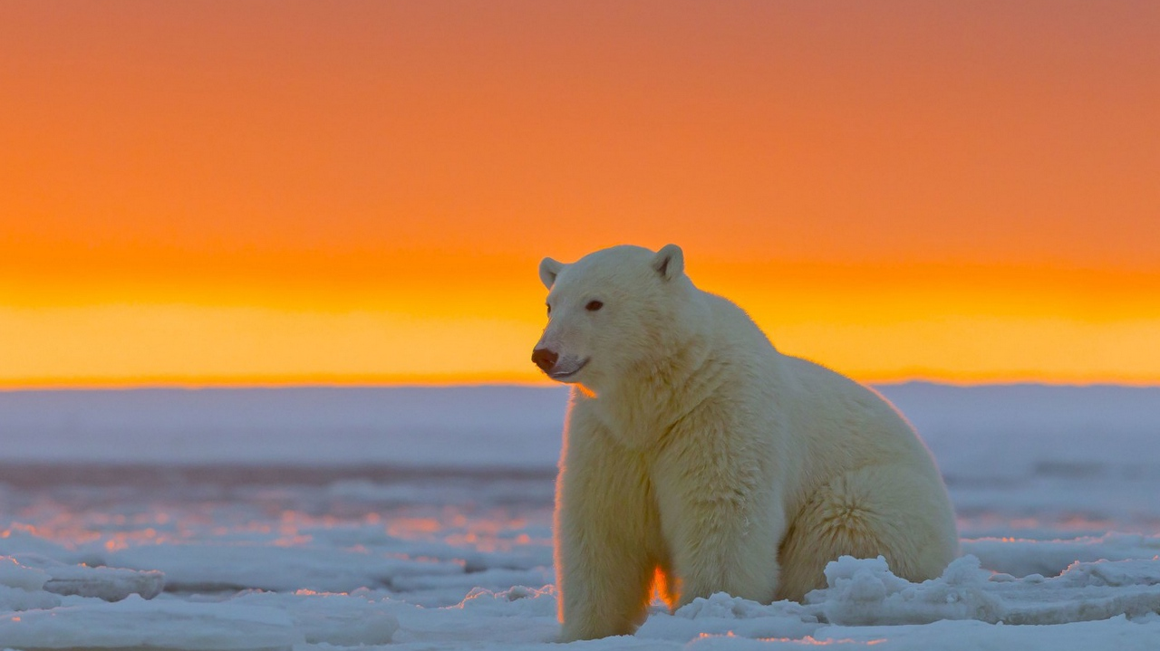
We cannot segregate the human heart from the environment outside us and say that once one of these is reformed everything will be improved. Man is organic with the world. His inner life moulds the environment and is itself also deeply affected by it.
The one acts upon the other and
every abiding change in the life
of man is the result of these
mutual reactions.
Shoghi Effendi

