Slide 1

Be generous in prosperity, and thankful in adversity.
Be worthy of the trust of thy neighbor, and look upon him with a bright and friendly face.
Be a treasure to the poor, an admonisher to the rich, an answerer of the cry of the needy, a preserver of the sanctity of thy pledge.
Be fair in thy judgment, and guarded in thy speech.
Be unjust to no man, and show all meekness to all men.
Be as a lamp unto them that walk in darkness, a joy to the sorrowful, a sea for the thirsty, a haven for the distressed, an upholder and defender of the victim of oppression. Let integrity and uprightness distinguish all thine acts.
Be a home for the stranger, a balm to the suffering, a tower of strength for the fugitive.
Baha’u’llah (Bahá’i Writings)

Slide 2

To be continually giving out for the good of our fellows undeterred by the fear of poverty and reliant on the unfailing bounty of the Source of all wealth and all good that is the secret of right living.
Shoghi Effendi (Bahá’i Writings)

Slide 3

O ye that are the exponents of generosity and the manifestations thereof! Be generous unto them whom
ye find in manifest poverty.
O ye that are possessed of riches! Take heed lest outward appearance
deter you from benevolent deeds in the path of God, the Lord of all mankind.
Say: I swear by God! No one is despised in the sight of the Almighty for being poor. Rather is he exalted, if he is found to be of them who are patient. Blessed are the poor that are steadfast in patience.
Baha’u’llah (Bahá’i Writings)

Slide 4
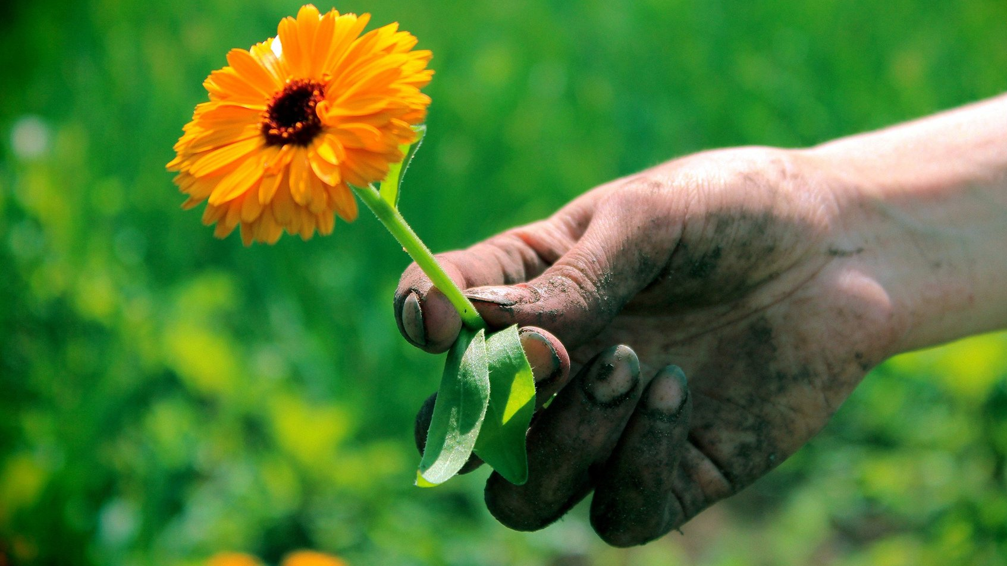
You often say, ‘I would give, but only to the deserving.’ The trees in your orchard say not so, nor the flocks in your pasture. They give that they may live, for to withhold is to perish.
Kahlil Gibran

Slide 5

There is no doubt that the civilization envisioned by Bahá’u’lláh is a prosperous one, both in its spiritual and material dimensions. To build a prosperous society free from the scourges of injustice and misery, we must all be generous and giving, and transcend the patterns of accumulation and utilization of material means only for the satisfaction of one’s own needs and desires. Generosity is an attribute of the human soul and is independent of the degree of wealth or poverty. A generous soul gives continually for the service of others whether of time, energy or material resources.
Universal House of Justice (Bahá’i Writings)

Slide 6

O CHILDREN OF DUST!
Tell the rich of the midnight sighing of the poor, lest heedlessness lead them into the path of destruction, and deprive them of the Tree of Wealth. To give and to be generous are attributes of Mine; well is it with him that adorneth himself with My virtues.
Baha’u’llah (Bahá’i Writings)

Slide 7

Every man must decide whether he will walk in the light of creative altruism or in the darkness of destructive selfishness.
Martin Luther King, Jr.

Slide 8

And the honor and distinction of the individual consist in this, that he among all the world’s multitudes should become a source of social good. Is any larger bounty conceivable than this, that an individual, looking within himself, should find that by the confirming grace of God he has become the cause of peace and well-being, of happiness and advantage to his fellow men?
‘Abdu’l-Bahá (Bahá’i Writings)

Slide 9
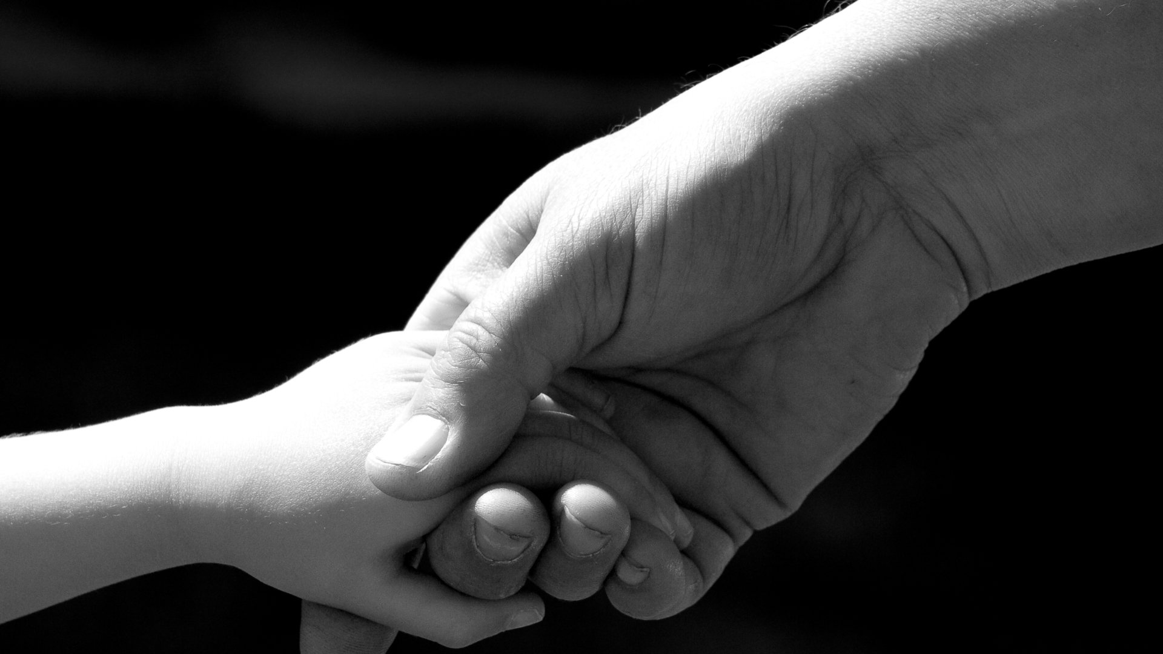
Man’s merit lieth in service and virtue and not in the pageantry of wealth and riches.
Baha’u’llah (Bahá’i Writings)

