Slide 1
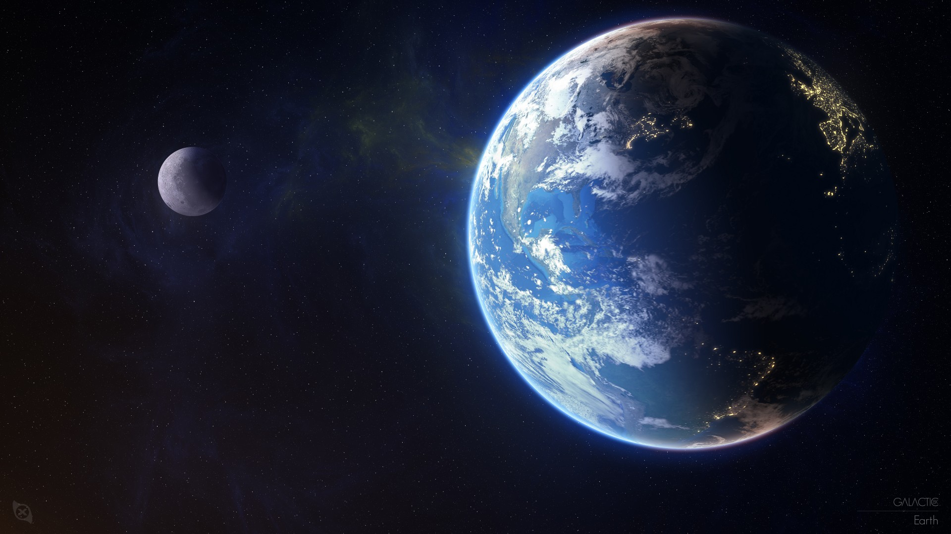
Bahá’u’lláh taught the Oneness of humanity;
that is to say, all the children of men are under
the mercy of the Great God. They are the sons of
one God; they are trained by God. He has placed
the crown of humanity on the head of every one of
the servants of God. Therefore all nations and
peoples must consider themselves brethren. They are all descendants from Adam. They are the branches, leaves, flowers and fruits of One Tree. They are pearls from one shell.
‘Abdu’l-Bahá

Slide 2

The well-being of mankind, its peace and security, are unattainable unless and until its unity is firmly established.
Baha’u’llah

Slide 3
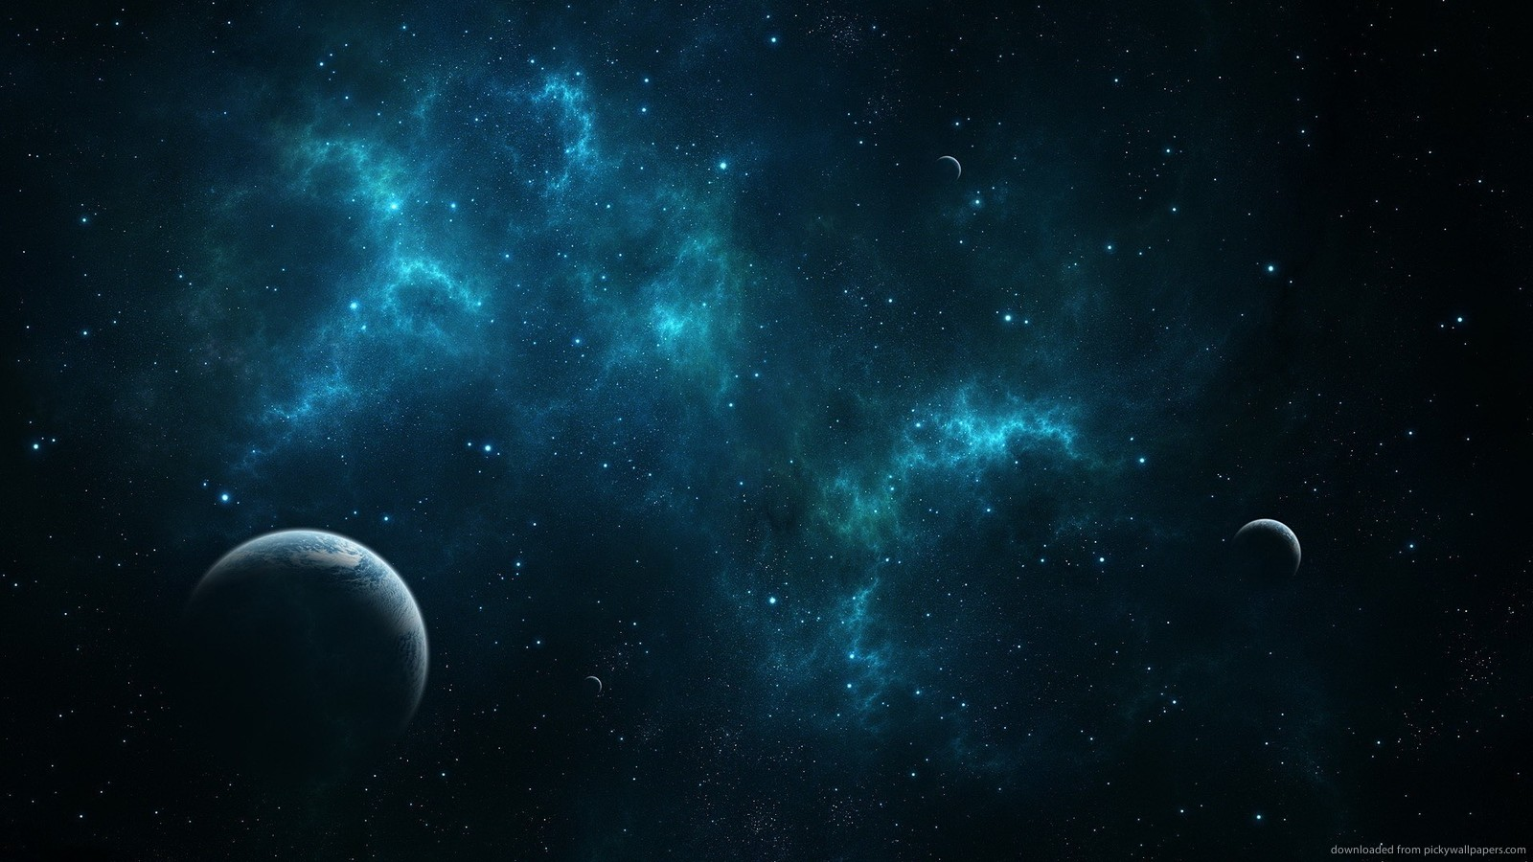
A person experiences life as something separated from the rest - a kind of optical delusion of consciousness. Our task must be to free ourselves from this self-imposed prison, and through compassion, to find the reality of Oneness.
Albert Einstein

Slide 4

It is not for him to pride himself who loveth his own country, but rather for him who loveth the whole world. The earth is but one country, and mankind its citizens.
Baha’u’llah

Slide 5

The recognition of the oneness of mankind would require the abandonment of all doctrines of superiority, many of which still persist implicitly despite our preoccupation with its more obvious forms such as apartheid. More importantly, by establishing the foundation for true co-operation, the recognition of this principle would raise civilization to a new level. At this higher level, no one need fear oppression, even those who were formerly oppressors. The sharing of power and responsibility among all citizens can then be implemented without fear, through appropriate legal measures and equitable social and economic policies.
Bahá’í International Community, Eliminating Racism Report

Slide 6

Whatever affects one directly, affects all indirectly. I can never be what I ought to be until you are what you ought to be. This is the interrelated structure of reality.
Martin Luther King, Jr.

Slide 7

As you know from your study of the Bahá’í writings, the principle that is to infuse all facets of organized life on the planet is the oneness of humankind, the hallmark of the age of maturity. That humanity constitutes a single people is a truth that, once viewed with scepticism, claims widespread acceptance today. The rejection of deeply ingrained prejudices and a growing sense of world citizenship are among the signs of this heightened awareness.
Yet, however promising the rise in collective consciousness may be, it should be seen as only the first step of a process that will take decades--nay, centuries--to unfold. For the principle of the oneness of humankind, as proclaimed by Bahá’u’lláh, asks not merely for cooperation among people and nations. It calls for a complete reconceptualization of the relationships that sustain society.
Universal House of Justice

Slide 8

The beings, whether great or small, are connected with one another by the perfect wisdom of God, and affect and influence one another. If it were not so, in the universal system and the general arrangement of existence, there would be disorder and imperfection.
‘Abdu’l-Bahá

Slide 9
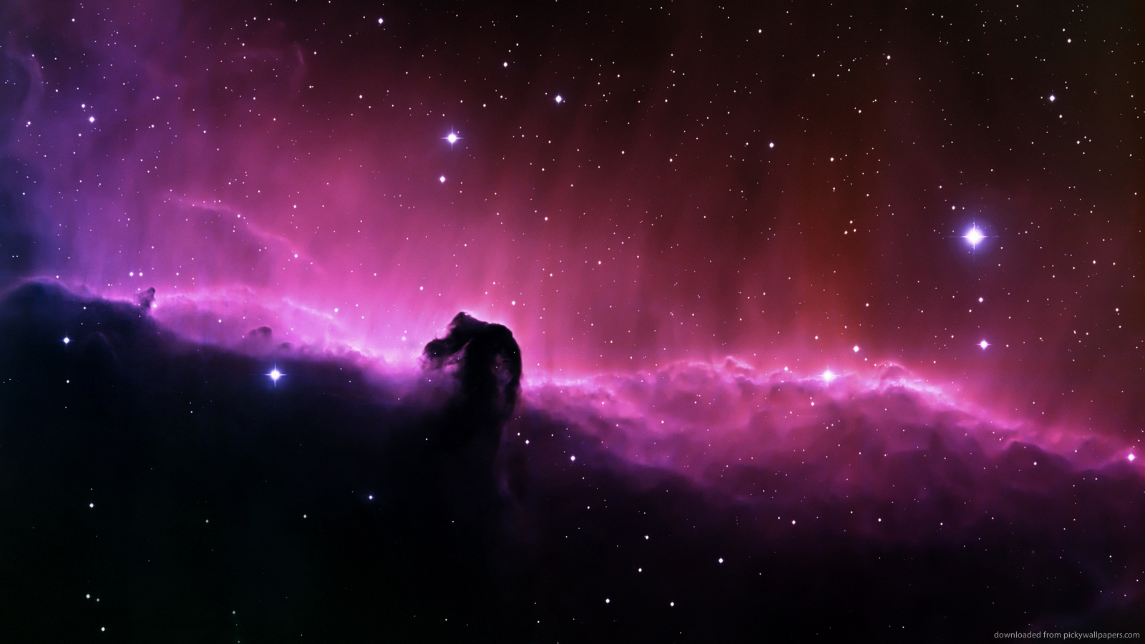
Quantum physics thus reveals a basic oneness of the universe.
Erwin Schrodinger

Slide 10

Let all be united in this Divine power of love! Let all strive to grow in the light of the Sun of Truth, and reflecting this luminous love on all men, may their hearts become so united that they may dwell evermore in the radiance of the limitless love…When you love a member of your family or a compatriot, let it be with a ray of the Infinite Love! Let it be in God, and for God! Wherever you find the attributes of God love that person, whether he be of your family or of another. Shed the light of a boundless love on every human being whom you meet, whether of your country, your race, your political party, or of any other nation, color or shade of political opinion. Heaven will support you while you work in this ingathering of the scattered peoples of the world beneath the shadow of the almighty tent of unity.
Abdu’l-Baha

Slide 11
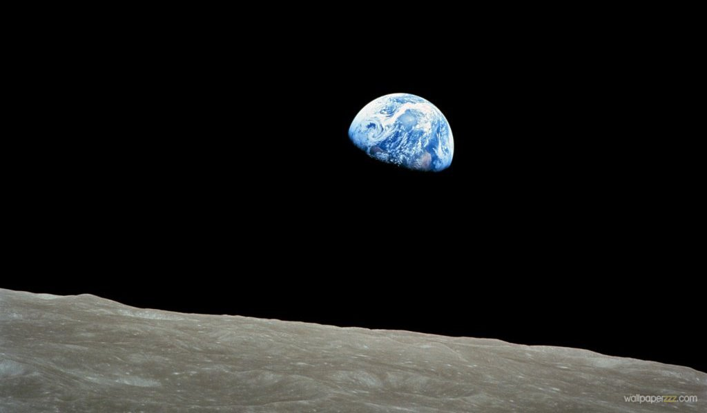
O CHILDREN OF MEN! Know ye not why We created you all from the same dust? That no one should exalt himself over the other. Ponder at all times in your hearts how ye were created. Since We have created you all from one same substance it is incumbent on you to be even as one soul, to walk with the same feet, eat with the same mouth and dwell in the same land, that from your inmost being, by your deeds and actions, the signs of oneness and the essence of detachment may be made manifest.
Baha’u’llah

