Slide 1
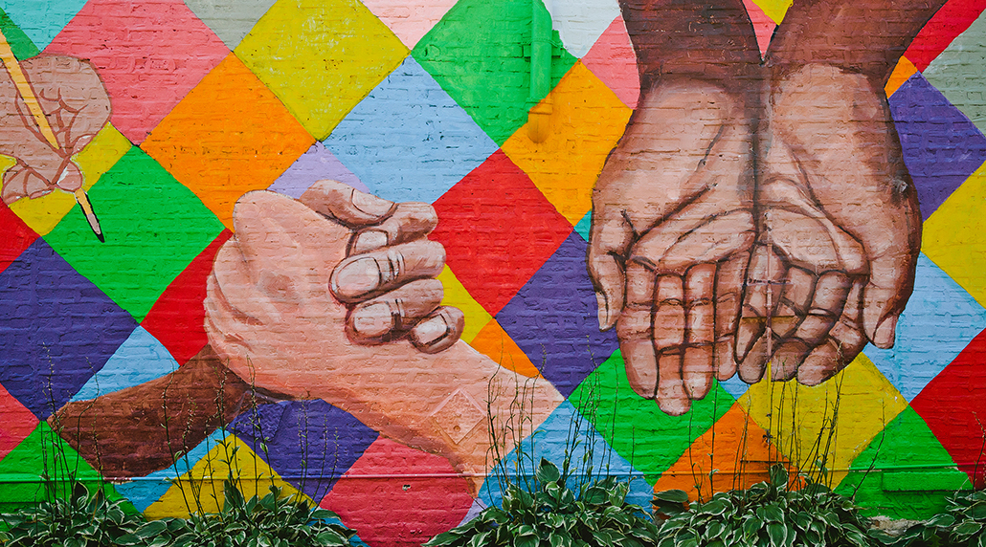
Close your eyes to racial differences and welcome all with the light of oneness.
Bahá’u’lláh

Slide 2
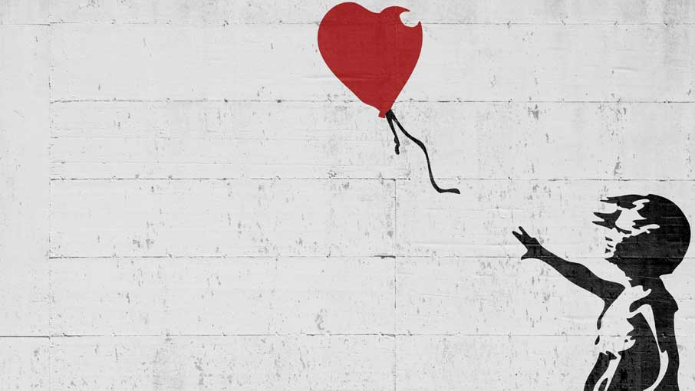
Racism originates not in the skin but in the human mind. Remedies to racial prejudice, xenophobia and intolerance must accordingly address first and foremost those mental illusions that have for so many thousands of years given rise to false concepts of superiority and inferiority among human populations.
At the root of all forms of discrimination and intolerance is the erroneous idea that humankind is somehow composed of separate and distinct races, peoples or castes, and that those sub-groups innately possess varying intellectual, moral, and/or physical capacities, which in turn justify different forms of treatment.
The reality is that there is only the one human race. We are a single people, inhabiting the planet Earth, one human family bound together in a common destiny, a single entity created from one same substance. Recognition of this reality is the antidote to racism, xenophobia and intolerance in all its forms.
Baháʼí International Community

Slide 3
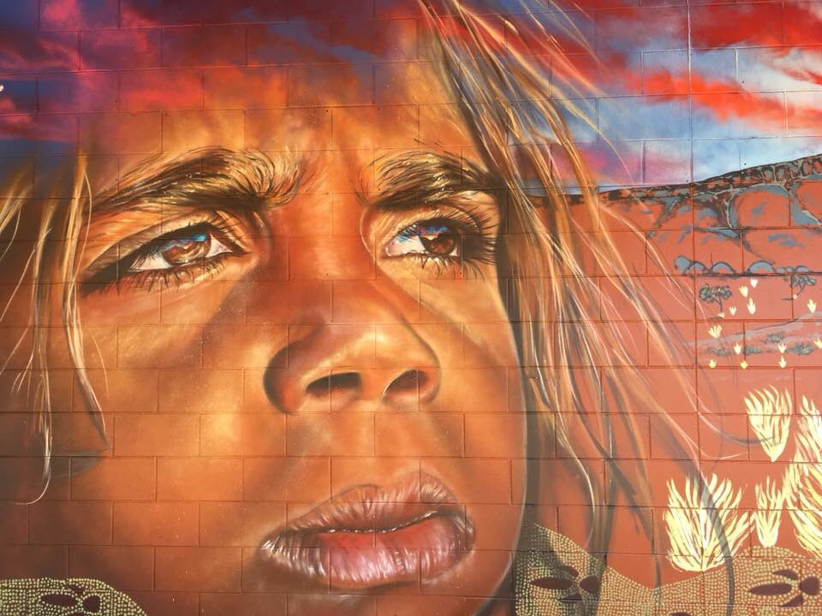
We must be the change we wish to see in the world.
Mahatma Gandhi

Slide 4
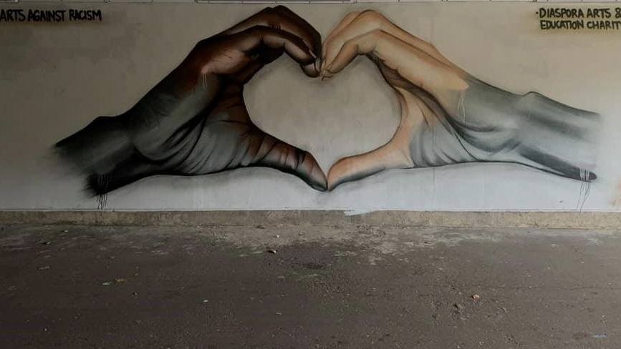
Prejudices of religion, race or sect destroy the foundation of Humanity. All the divisions in the world, hatred, war and bloodshed, are caused by one or other of these prejudices. The whole world must be looked upon as one single country, all the nations as one nation, all men as belonging to one race. Religions, races, and nations are all divisions of man’s making only, and are necessary only in his thought; before God there are neither Persians, Arabs, French nor English; God is God for all, and to Him all creation is one. We must obey God, and strive to follow Him by leaving all our prejudices and bringing about peace on earth.
‘Abdu’l-Bahá

Slide 5
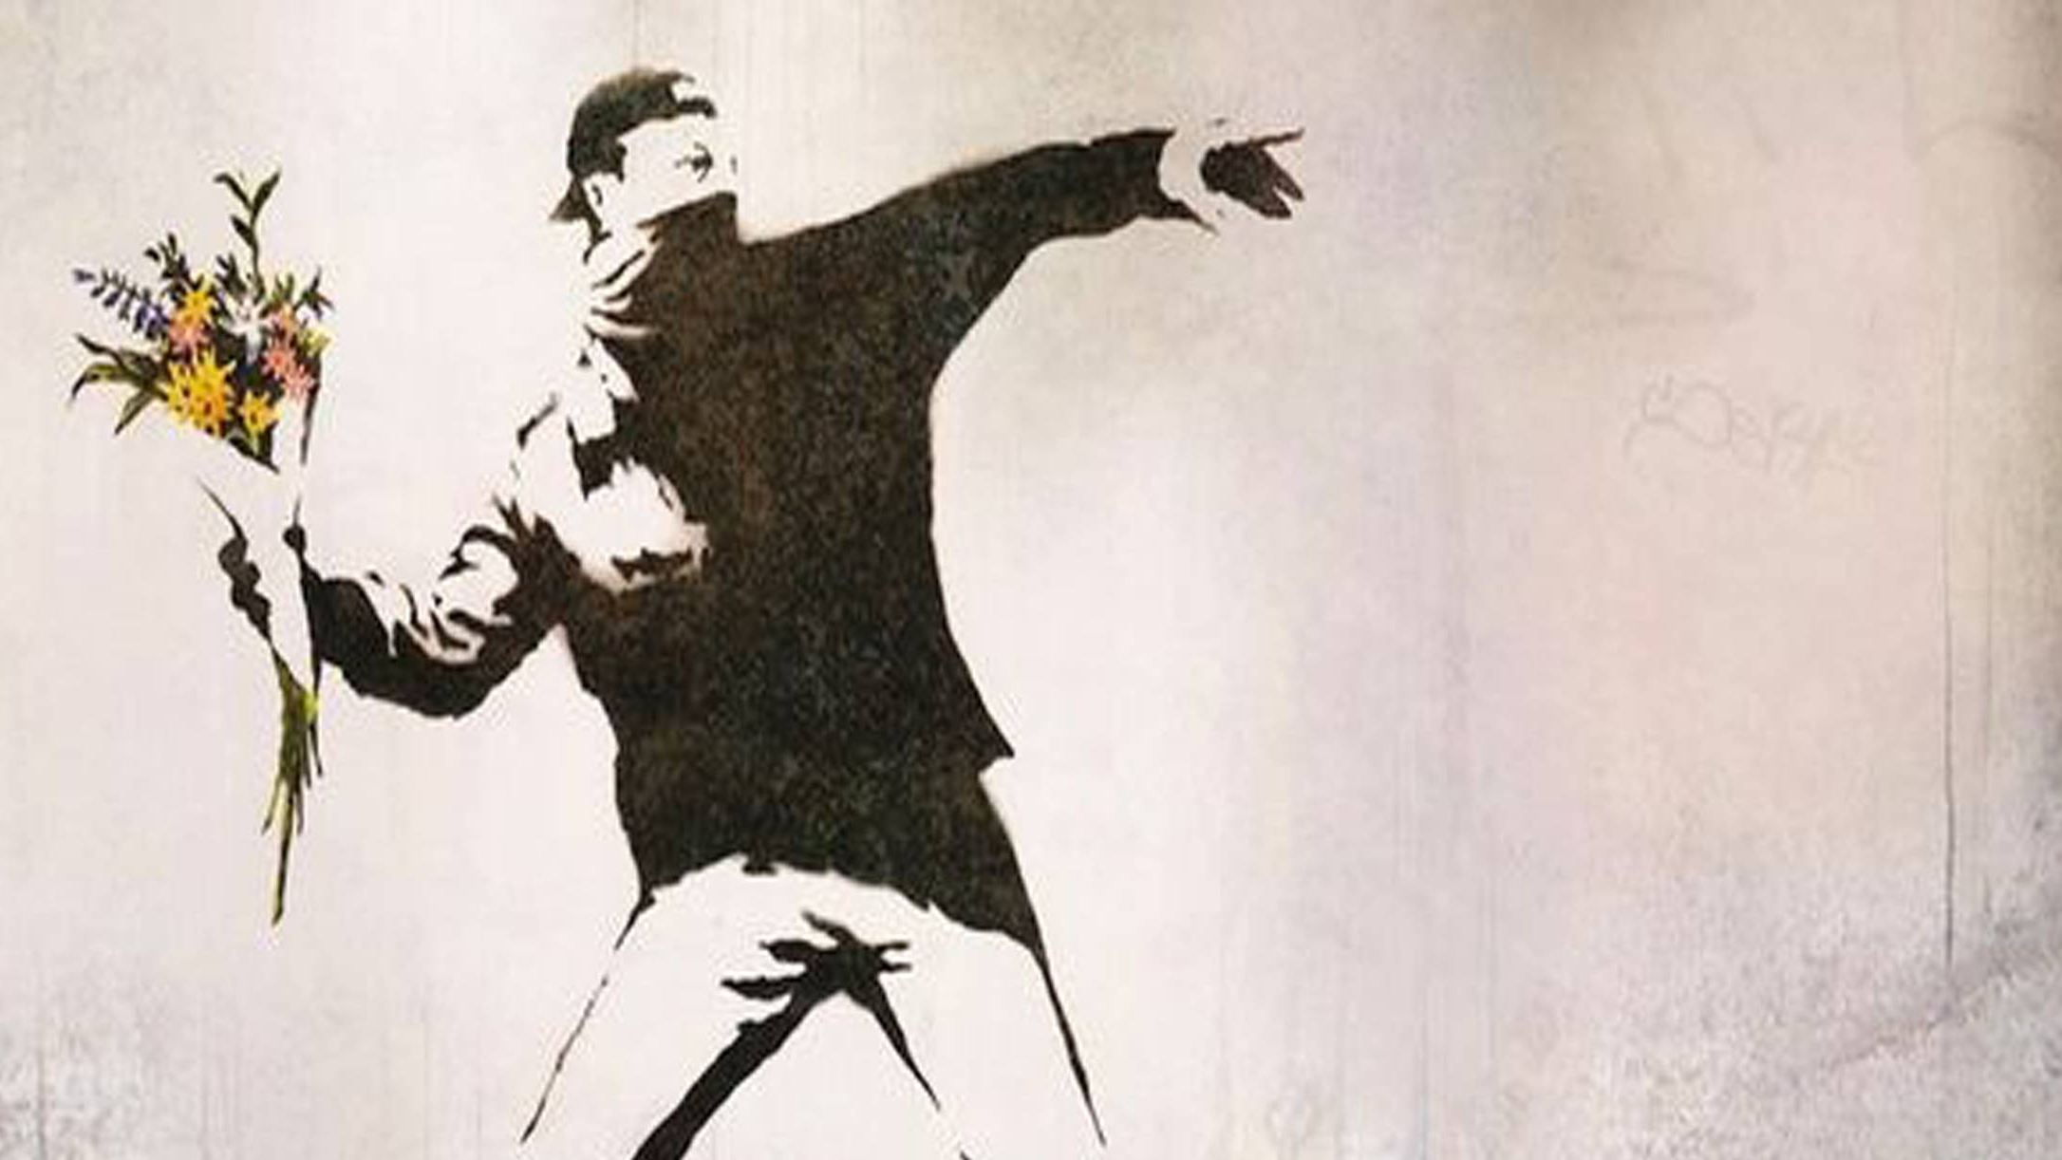
Let the white make a supreme effort...to abandon once for all their usually inherent and at times subconscious sense of superiority, to correct their tendency towards revealing a patronizing attitude towards the members of the other race, to persuade them through their intimate, spontaneous and informal association with them of the genuineness of their friendship and the sincerity of their intentions, and to master their impatience of any lack of responsiveness on the part of a people who have received, for so long a period, such grievous and slow-healing wounds.
Shoghi Effendi

Slide 6
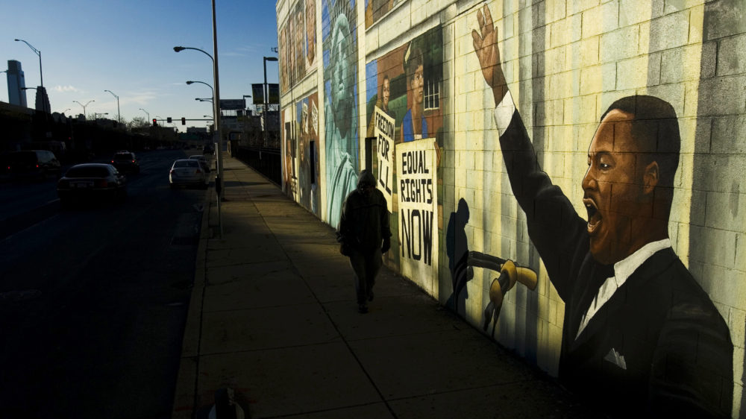
…there is need of a superior power to
overcome human prejudices, a power
which nothing in the world of mankind
can withstand and which will overshadow
the effect of all other forces at work in human
conditions. That Irresistible power is the love
of God. It is my hope and prayer that it may destroy
the prejudice of this one point of distinction between you
and unite you all permanently under its hallowed protection.
Bahá’u’lláh has proclaimed the oneness of the world of humanity.
He has caused various nations and divergent creeds to unite. He has declared that difference of race and color is like the variegated beauty of flowers in a garden.
‘Abdu’l-Bahá

Slide 7
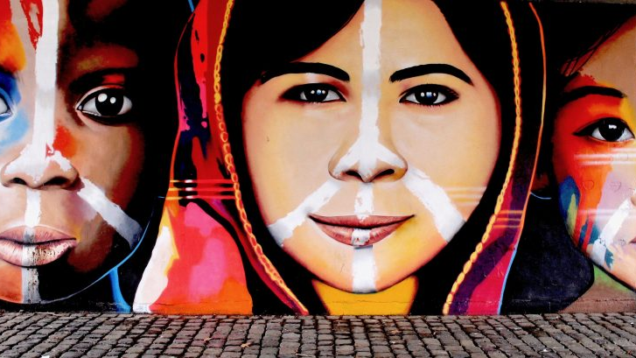
Injustice anywhere is a threat to justice everywhere.
Martin Luther King, Jr.

Slide 8
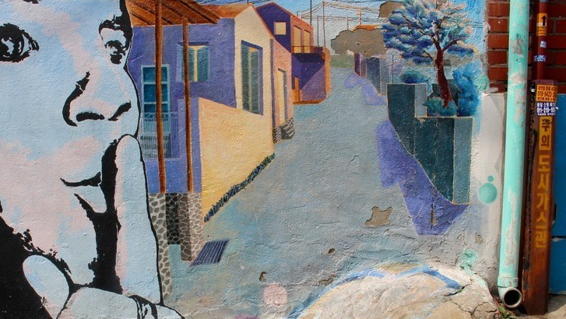
Through our ignorance and lack of viewpoint we divide this common home, we divide the members of this family into various races, we divide religion into different sects and then with those suppositional divisions we wage war against one another; we shed one another’s blood and we pillage one another’s possessions.
Is not this unpardonable ignorance?
Is this not the height of injustice?
Were we just and could we observe without prejudice we would realize that there are no fundamental differences.
‘Abdu’l-Bahá

Slide 9
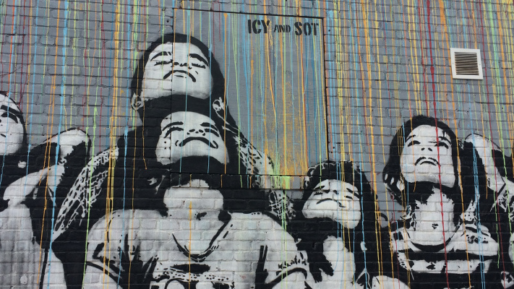
This earth is one household and the nativity of all humanity; therefore the human race should ignore distinctions and boundaries which are artificial …
the reality is that humanity is one … Therefore false distinctions of race and nativity, which are factors and causes of warfare, must be abandoned.
‘Abdu’l-Bahá

Slide 10
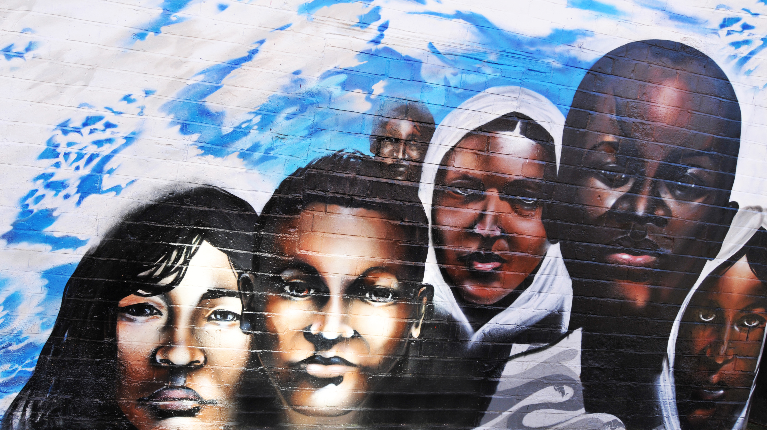
The diversity in the human family should be the cause of love and harmony, as it is in music where many different notes blend together in the making of a perfect chord. If you meet those of different race and colour from yourself, do not mistrust them and withdraw yourself into your shell of conventionality, but rather be glad and show them kindness. Think of them as different coloured roses growing in the beautiful garden of humanity, and rejoice to be among them.
‘Abdu’l-Bahá

Slide 11

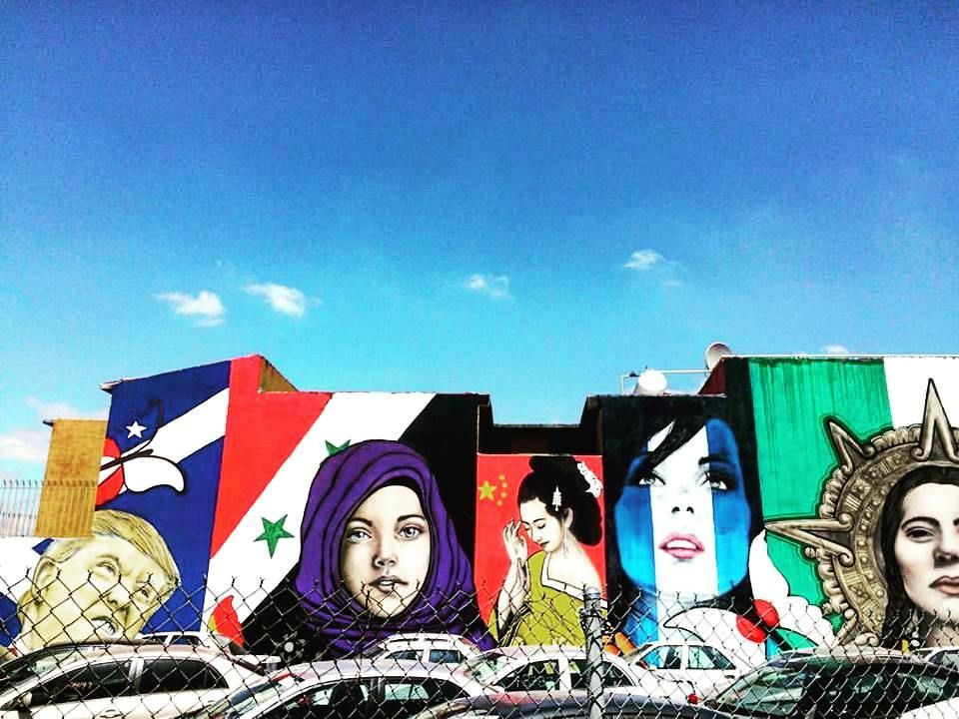
No one is born hating another person because of the color of his skin, or his background, or his religion. People must learn to hate, and if they can learn to hate, they can be taught to love, for love comes more naturally to the human heart than its opposite.
Nelson Mandela

Slide 12

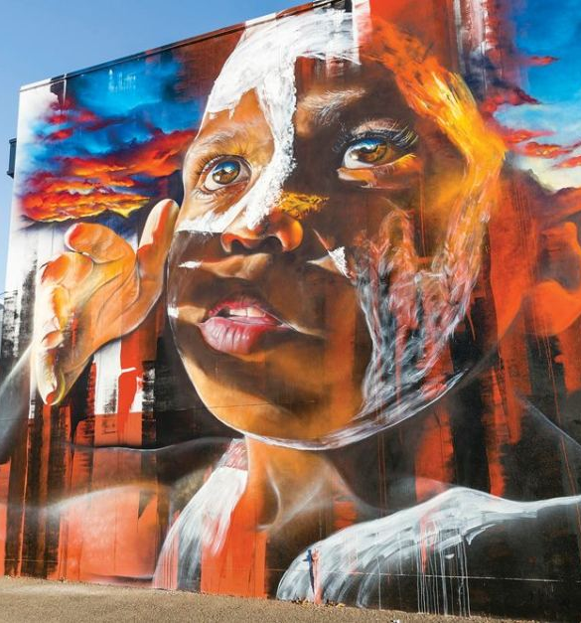
Just as a fever is a symptom of disease in the body, racism is a symptom of disease in society. Suppressing the symptom does not cure the disease, but curing the disease eliminates the symptom. The Baháʼí International Community is convinced that the disease from which society currently suffers is failure to recognize the principle of the oneness of humanity, and racism is but a symptom. If we wish to eliminate racism entirely, we must establish, as the moral of foundation for society, the unshakable conviction of the oneness of the human race.
Baháʼí International Community

Slide 13
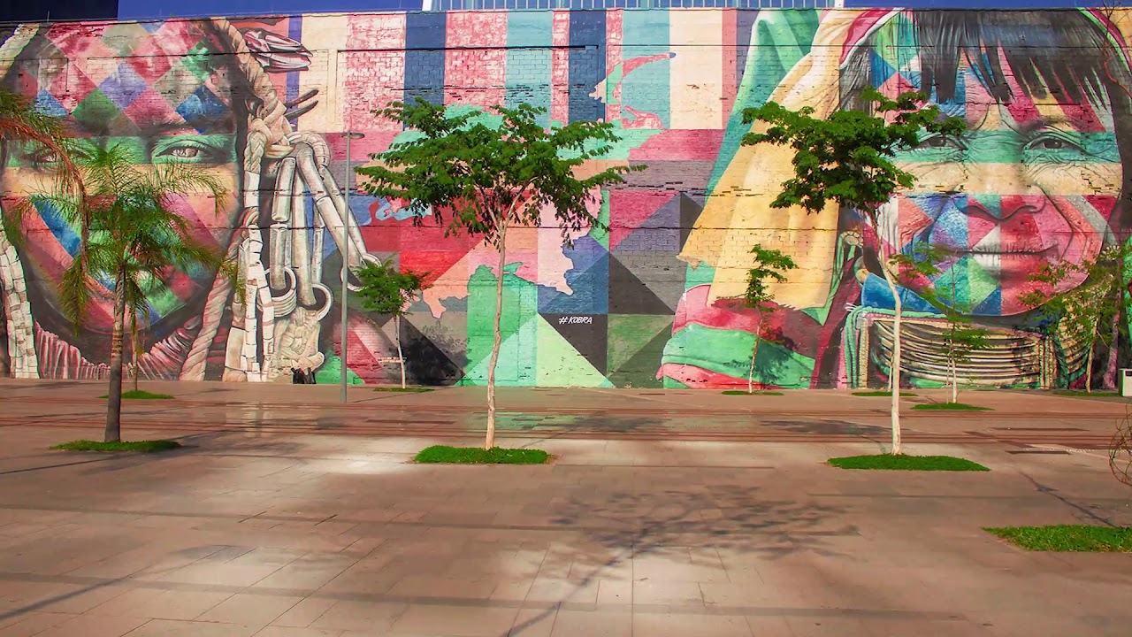
The time has come when all mankind shall be united, when all races shall be loyal to one fatherland, all religions become one religion and racial and religious bias pass away.
It is a day in which the oneness of humankind shall uplift its standard and international peace like the true morning flood the world with its light.
‘Abdu’l-Bahá

