Slide 1

But the religion which does not walk hand in hand with science is itself in the darkness of superstition and ignorance.
‘Abdu’l-Bahá

Slide 2

Religion must stand the analysis of reason. It must agree with scientific fact and proof so that science will sanction religion and religion fortify science. Both are indissolubly welded and joined in reality.
‘Abdu’l-Bahá

Slide 3
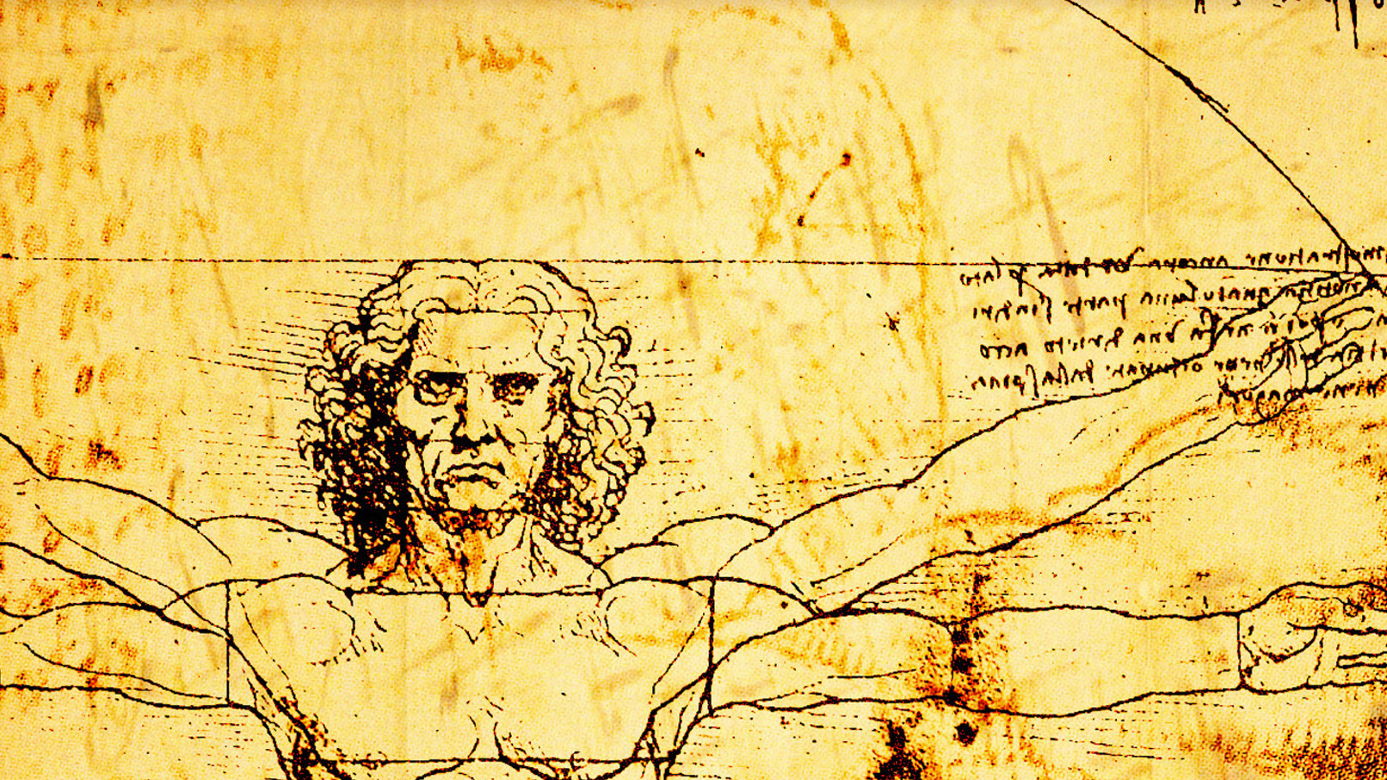
We know very little, and yet it is astonishing that we know so much, and still more astonishing that so little knowledge can give us so much power.
Bertrand Russell

Slide 4
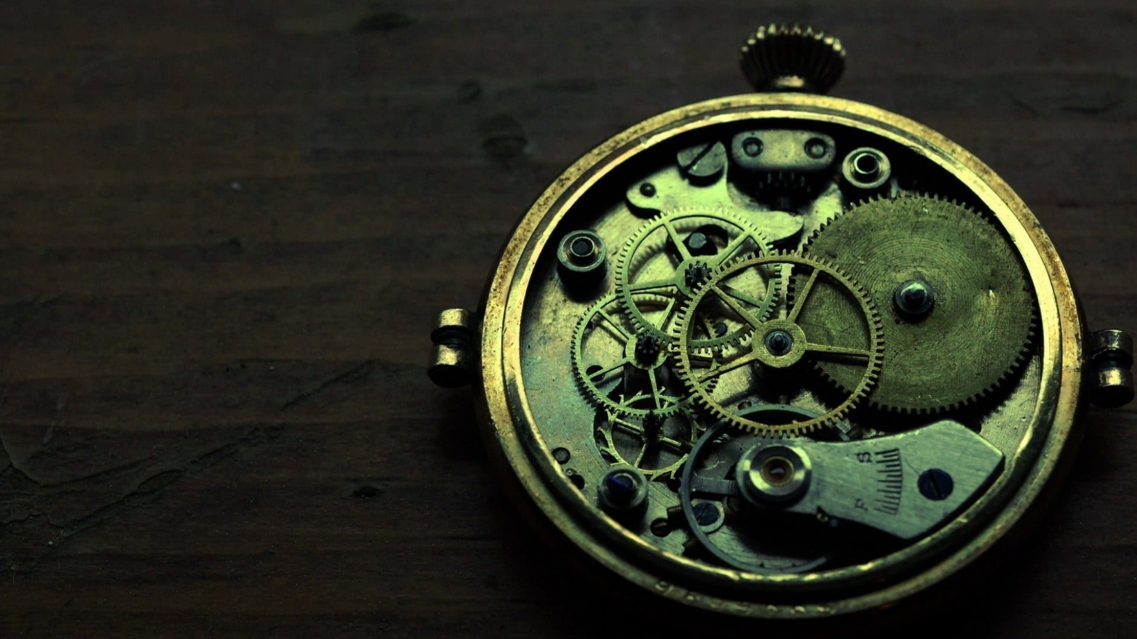
Religion is religion, as science is science. The one discerns and articulates the values unfolding progressively through Divine revelation; the other is the instrumentality through which the human mind explores and is able to exert its influence ever more precisely over the phenomenal world. The one defines goals that serve the evolutionary process; the other assists in their attainment. Together, they constitute the dual knowledge system impelling the advance of civilization.
The Universal House of Justice

Slide 5

… science is penetrating the mysteries of the universe, the oneness of the world of humanity is being established, and service to mankind is the paramount motive of all existence. Shall we remain steeped in our fanaticisms and cling to our prejudices? Is it fitting that we should still be bound and restricted by ancient fables and superstitions of the past, be handicapped by superannuated beliefs and the ignorances of dark ages, waging religious wars, fighting and shedding blood, shunning and anathematizing each other? Is this becoming? Is it not better for us to be loving and considerate toward each other?
‘Abdu’l-Bahá

Slide 6
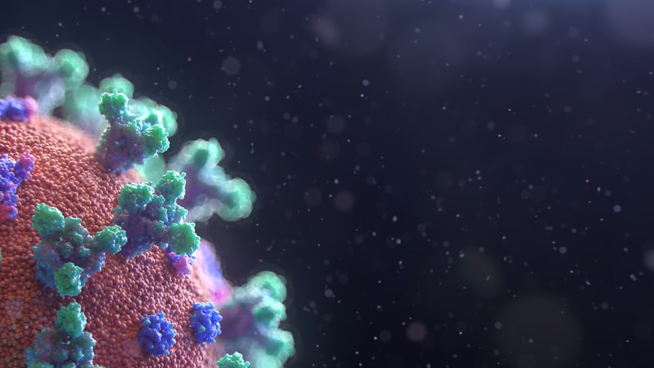
One of the fundamental teachings of Bahá’u’lláh is that true science and true religion must always be in harmony. Truth is one, and whenever conflict appears it is due, not to truth, but to error. Between so-called science and so-called religion there have been fierce conflicts all down the ages, but looking back on these conflicts in the light of fuller truth we can trace them every time to ignorance, prejudice, vanity, greed, narrow-mindedness, intolerance, obstinacy or something of the kind -- something foreign to the true spirit of both science and religion, for the spirit of both is one.
Dr. J.E. Esslemont

Slide 7
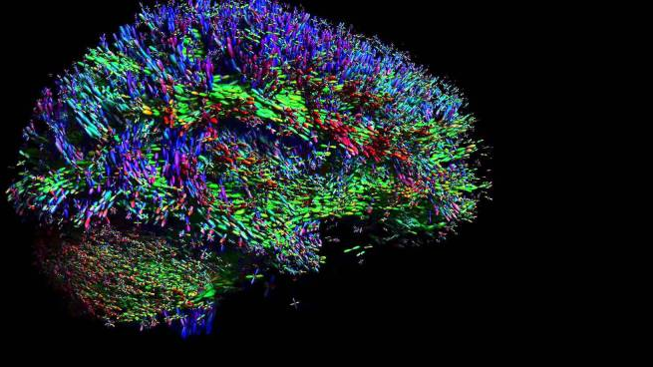
Nothing in life is to be feared, it is only to be understood. Now is the time to understand more, so that we may fear less.
Marie Curie

Slide 8

Put all your beliefs into harmony with science; there can be no opposition, for truth is one. When religion, shorn of its superstitions, traditions, and unintelligent dogmas, shows its conformity with science, then will there be a great unifying, cleansing force in the world which will sweep before it all wars, disagreements, discords and struggles -- and then will mankind be united in the power of the Love of God.
‘Abdu’l-Bahá

Slide 9
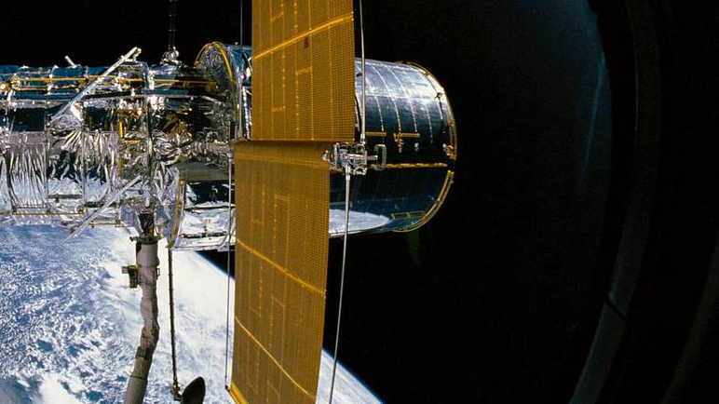
Religion and Science are inter-twined with each other and cannot be separated. These are the two wings with which humanity must fly. One wing is not enough. Every religion which does not concern itself with Science is mere tradition, and that is not the essential. Therefore science, education and civilization are most important necessities for the full religious life.
‘Abdu’l-Bahá

Slide 10

The greatest attainment in the world of humanity has ever been scientific in nature. It is the discovery of the realities of things….
The highest praise is due to men who devote their energies to science, and the noblest center is a center wherein the sciences and arts are taught and studied. Science ever tends to the illumination of the world of humanity.
‘Abdu’l-Bahá

Slide 11

What we know is a drop, what we don’t know is an ocean.
Isaac Newton

Slide 12

Knowledge is as wings to man's life, and a ladder for his ascent. Its acquisition is incumbent upon everyone. The knowledge of such sciences, however, should be acquired as can profit the peoples of the earth, and not those which begin with words and end with words. Great indeed is the claim of scientists and craftsmen on the peoples of the world.... In truth, knowledge is a veritable treasure for man, and a source of glory, of bounty, of joy, of exaltation, of cheer and gladness unto him.
Bahá'u'lláh

