Slide 1
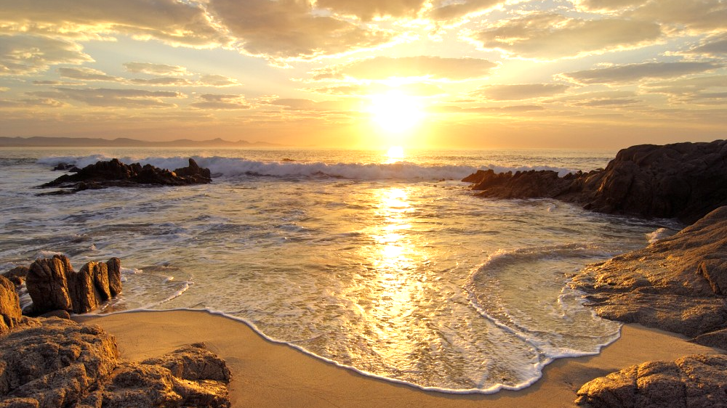
We would like to acknowledge the Custodians of the lands and waters where we meet tonight, the Wathaurong people, and thank them for their eternal protection, love, and care of the space upon which we live.
We pay our respects to Elders past and present, and extend our respects to all Aboriginal and Torres Strait Islander First Nations People.

Slide 2
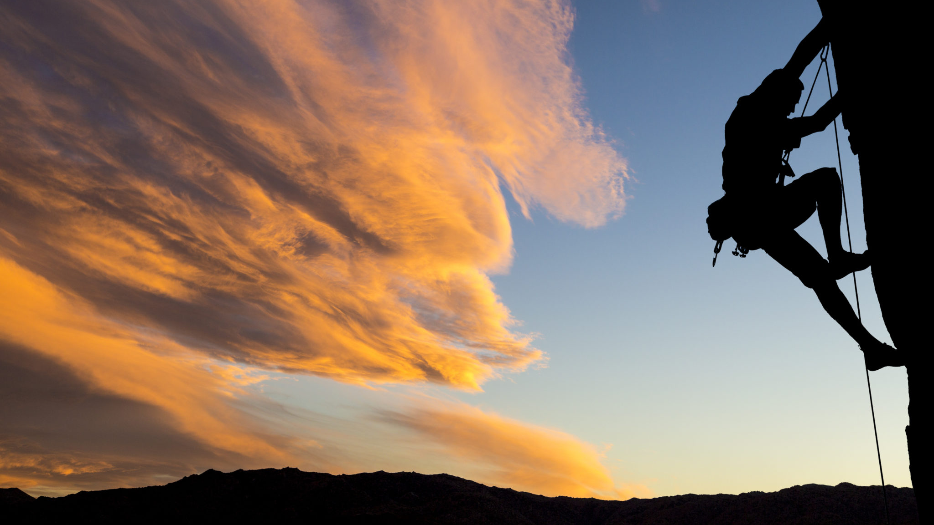
There are four qualities which I love to see manifested in people: first, enthusiasm and courage; second, a face wreathed in smiles and a radiant countenance; third, that they see with their own eyes and not through the eyes of others; fourth, the ability to carry a task once begun, through to its end.
Baháʼu'lláh

Slide 3

Perseverance is an essential condition. In every project firmness and steadfastness will undoubtedly lead to good results; otherwise it will exist for some days, and then be discontinued.
‘Abdu’l-Bahá

Slide 4
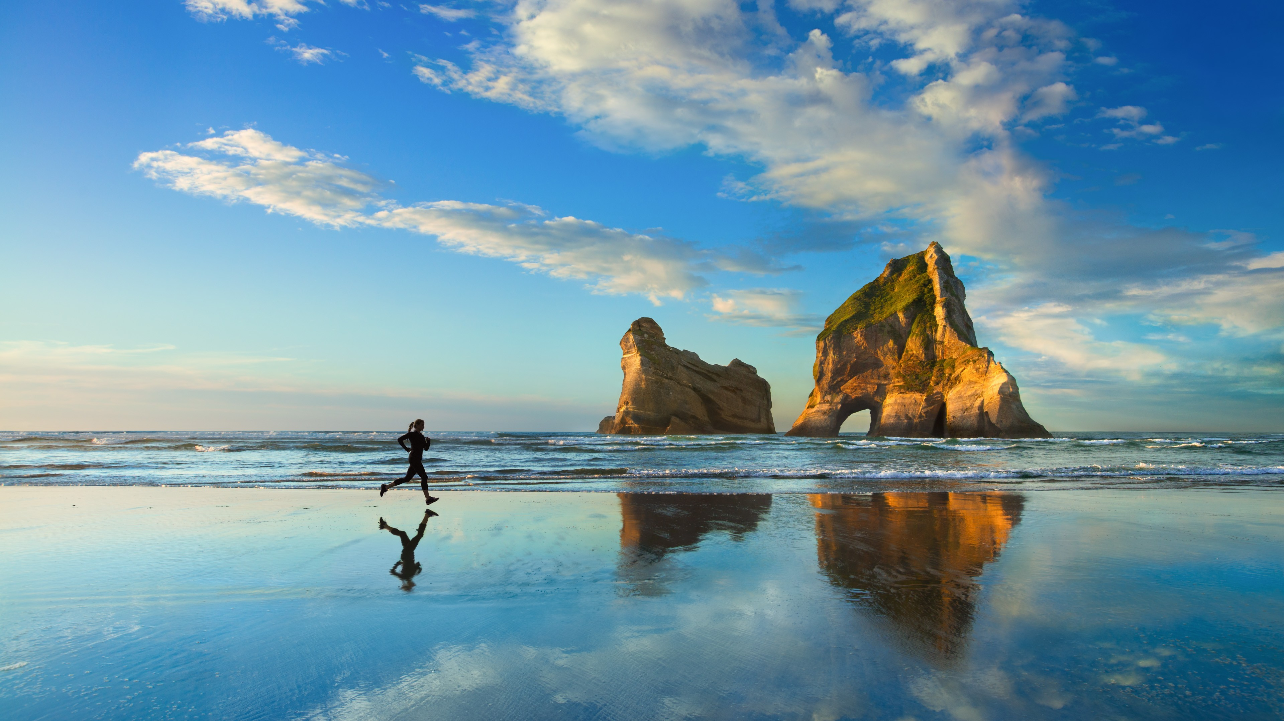
Many of life's failures are people who did not realize how close they were to success when they gave up.
Thomas Edison

Slide 5

Victories are won usually through a great deal of patience, planning and perseverance, and rarely accomplished at a single stroke.
Shoghi Effendi

Slide 6

Just now the soil of human hearts seems like black earth, but in the innermost substance of this dark soil there are thousands of fragrant flowers latent. We must endeavor to cultivate and awaken these potentialities, discover the secret treasure in this very mine and depository of God, bring forth these resplendent powers long hidden in human hearts.
Then will the glories of both worlds be blended and increased and the quintessence of human existence be made manifest.
‘Abdu’l-Bahá

Slide 7

Lift up your hearts above the present and look with eyes of faith into the future!
Today the seed is sown, the grain falls upon the earth, but behold the day will come when it shall rise a glorious tree and the branches thereof shall be laden with fruit.
‘Abdu’l-Bahá

Slide 8

It does not matter how slowly you go so long as you do not stop.
Confucius

Slide 9
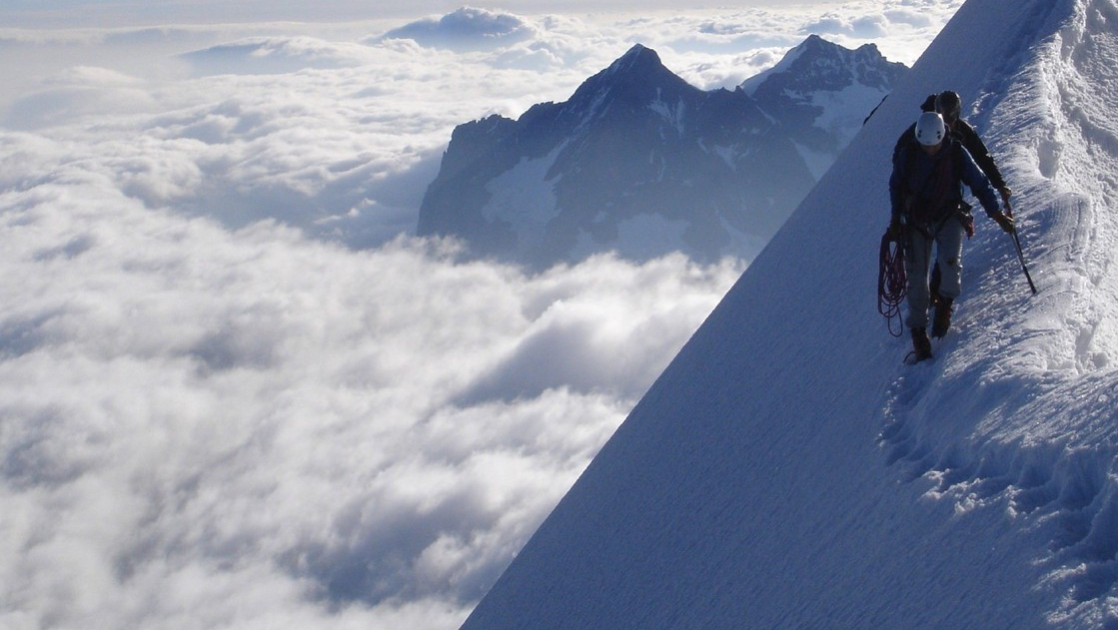
Know, verily, that the seed, however virile it may be, however strong the hand of the sower, however pure the water that watereth it, it is impossible for it to grow, blossom and bear fruit in a short time; nay, a long period is needed for its development.
So it is the Kingdom of God. Consider the seed which was sown by Christ; verily, it did not blossom until after a long period. Thus it is incumbent upon thee to be patient in all affairs.
Verily thy Lord is powerful, forgiving, precious and persevering! Depend upon the favor of thy Lord. He shall bless thee and protect thee under the shadow of His generosity and mercy.
‘Abdu’l-Bahá

Slide 10

Work ye for the guidance of the women in that land, teach the young girls and the children, so that the mothers may educate their little ones from their earliest days, thoroughly train them, rear them to have a goodly character and good morals, guide them to all the virtues of humankind, prevent the development of any behaviour that would be worthy of blame, and foster them in the embrace of Bahá’í education. Thus shall these tender infants be nurtured at the breast of the knowledge of God and His love. Thus shall they grow and flourish, and be taught righteousness and the dignity of humankind, resolution and the will to strive and to endure. Thus shall they learn perseverance in all things, the will to advance, high mindedness and high resolve, chastity and purity of life. Thus shall they be enabled to carry to a successful conclusion whatsoever they undertake.
‘Abdu’l-Bahá

Slide 11

The one in pursuit of anything must undergo difficulties and hardships until the object in view is attained and the great success is obtained. This is the case of things pertaining to the world.
‘Abdu’l-Bahá

Slide 12
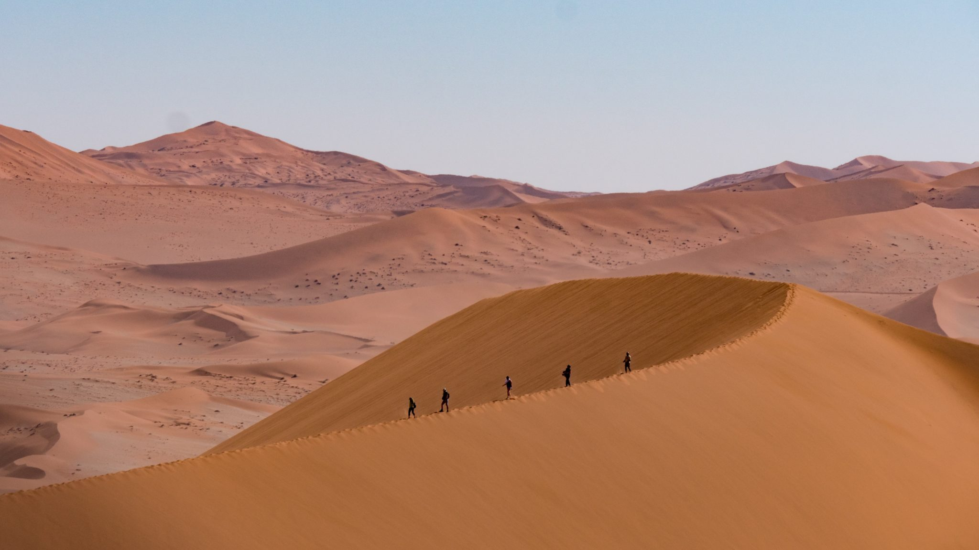
Courage is not having the strength to go on; it is going on when you don't have the strength.
Theodore Roosevelt

Slide 13

One dark night, as ‘Abdu’l-Bahá paced up and down the long front hallway of the reception room, relaxing and easing the stresses of a busy day, He asked me the following question. ‘Do you know how I administer this Faith?’ Then He said, ‘I pull the sails of the ship firmly and fasten the ropes tight. I locate my destination and then by the power of my will I hold the wheel and head out. No matter how strong the storm, no matter how dangerous the threat to the safety of the ship, I do not change course. I do not become agitated or disheartened; I persevere until I reach my goal. If I were to hesitate or change direction at the sight of every danger, the Ark of the Cause of God would surely fail to reach its destination.’
Dr. Youness Afroukhteh

